Slide 1
HAROLD GATTY
Prince of Navigators

Slide 2
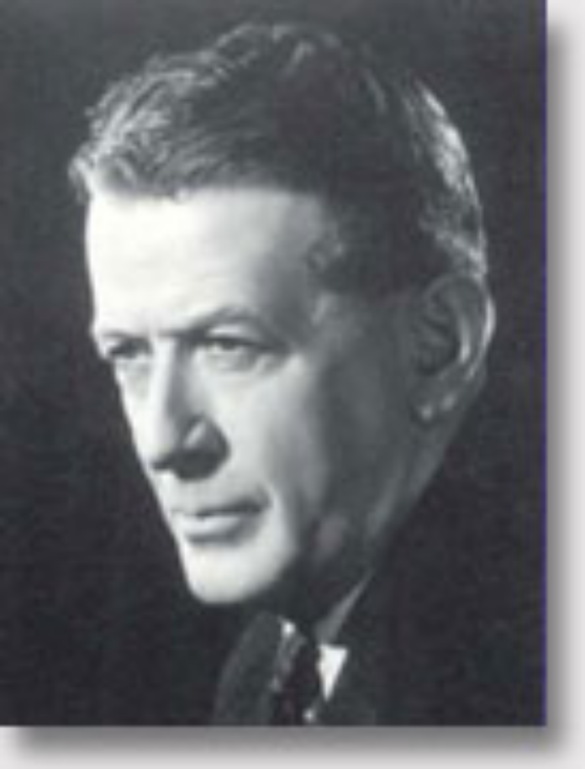
Harold Gatty
HAROLD GATTY WAS BORN IN CAMPBELL TOWN ON JANUARY 1901. HS FATHER WAS HEADMASTER OF THE LOCAL GOVERNMENT SCHOOL .
IN 1915 GATTY ENTERED ST. VIRGIL’S COLLEGE AS A BOARDER.
ON JANUARY 1st 1917 HE ENTERED JERVIS BAY NAVAL COLLEGE. HE WAS NOT A STAR PUPIL AND HAD MOST PROBLEMS WITH MATHS AND NAVIGATION.
A SEAGOING POSTING WAS OFFERED TO GATTY DUE TO LESS DEMAND FOR OFFICERS IN THE NAVY.

Slide 3
IN JUNE 1920 GATTY JOINED PATRICK SS CO AS AN APPRENTICE AND WENT ON THE SS GABO PLYING BETWEEN AUSTRALIAN PORTS AND NZ.
AFTER 3 YEARS GATTY SIGNED ON TO THE UNITED SS OF NZ AND WAS POSTED TO AN OIL TANKER WORKING BETWEEN NZ AND CALIFORNIA.
CROSSING THE PACIFIC GATTY STUDIED CELESTIAL NAVIGATION AND EXPERIMENTED WITH USING HIS SENSES AS NAVIGATIONAL AIDS EG: “NATURAL NAVIGATION-SMELL OF COCONUTS, GUANO-NEW MOWN HAY (NZ 80 MILES OUT).
OFF THE PACIFIC RUN GATTY FAILED IN AN APPLE SHIPPING SERVICE BETWEEN PORT HUON AND HOBART AND MOVED TO SYDNEY WHERE HE STRUGGLED TO FIND A JOB.
IN 1927 (HAVING MARRIED) GATTY APPLIED FOR AN ENTRY VISA TO THE US.
ARRIVING IN SAN FRANCISCO ON CHRISTMAS EVE 1927 GATTY FOUND HIS SEAGOING PAPERS ONLY WERE VALID FOR BRITISH EMPIRE SHIPS.

Slide 4
AFTER WORKING ON A PRIVATE YACHT OWNED BY SPAULDING THE SPORTS MILLIONARE GATTY OPENED HIS NEW BUSINESS –A NAVIGATION SCHOOL BASED IN LOS ANGELES.
OPERATING AS AN AGENCY FOR THE PIONEER INSTRUMENT CO GATTY CAME INTO CONTACT WITH AVIATORS USING AIRFIELDS AROUND LA.
AIR NAVIGATION WAS THEN PRIMITIVE. AFTER RUNNING HIS OWN PILOT TRAINING NAVIGATION SCHOOL IN SAN DIEGO GATTY TEAMED UP WITH LT.COMMANDER PHILLIP V.H. WEEMS A SERVING US NAVAL OFFICER.
GATTY WORKED TO IMPROVE WEEMS TABLES OF CALCULATED POSITION LINES”WEEMS CURVES” (USED BY ADMIRAL BYRD IN THE ARCTIC AND AUSTRALIAN HERBERT WILKINS IN THE ANTARCTIC).
AS THE WEEMS CURVES COULD ONLY BE USED AT NIGHT GATTY LOOKED TO DEVELOP DEAD RECKONING FOR AVIATION NAVIGATION.
HE INVENTED THE AIR SEXTANT AND THEN THEAEROCHRONOMETER.
THIS WAS DESIGNED TO OVERCOME THE EFFECT OF RAPID AIRCRAFT SPEED ON A CALCULATION.

Slide 5
GATTY ALSO DESIGNED AND BUILT THE GATTY DRIFT SIGHT TO FIX THE DETERMINATION OF GROUND SPEED OF AN AIRCRAFT AND THE ANGLE OF DRIFT (CROSSWIND EFFECT).
ALL THESE INVENTIONS ARE THE BASIS OF THE MODERN AUTOMATIC PILOT.
WEEMS PUBLISHED A TEXTBOOK “WEEMS SYSTEM OF AIR NAVIGATION” GIVING CREDIT TO GATTY FOR MUCH OF ITS DATA-DESCRIBING HIM AS “ A COMPASS AND MAP EXPERT WHO HAS DONE MORE PRACTICAL WORK ON CELESTIAL NAVIGATION THAN ANY OTHER PERSON IN THE WORLD TODAY”.
IN 1929 GATTY FLEW AS NAVIGATOR WITH ROSCOE TURNER FROM GLENDALE CALIFORNIA TO ROOSEVELT FIELD IN NEW YORK IN A LOCKHEED VEGA.T HE TIME MADE WAS 19 HRS 51 MINS AND WAS 2 HOURS SHORT OF THE RECORD.
IT WAS GATTY’S FIRST EXPERIENCE IN LONG DISTANCE AIR NAVIGATION AND BOOSTED HIS REPUTATION AS A TALENTED AND RELIABLE NAVIGATOR.

Slide 6
IN 1930 GATTY ACTED AS NAVIGATOR TO A CANADIAN FLYER HAROLD BROMLEY IN HIS ATTEMPTS IN “THE SPIRIT OF TACOMA” TO CROSS THE NORTH PACIFIC FROM THE US WEST COAST TO THE ISLANDS OF JAPAN.
ALTHOUGH THE ATTEMPT TO MAKE THE CROSSING FAILED GATTY PROVED ENDURANCE AND CAPABILTY- FLYING THROUGH FOG AND USING ONLY THE DEAD RECKONING SKILLS DEVELOPED WITH WEEMS AND GATTY’S MARITIME EXPERIENCES.
GATTY RESUMED HIS NAVIGATION INSTRUCTION IN LA AND HIS CLIENT NUMBERS INCREASED.
IN JANUARY 1931 WILEY POST A PILOT WITH EXPERIENCE IN OIL SURVEYING IN REMOTE PARTS OF THE US MET GATTY OFFERING THE POSITION OF NAVIGATOR IN “WINNIE MAE” FOR POST’S PLANNED ROUND THE WORLD FLIGHT.

Slide 7
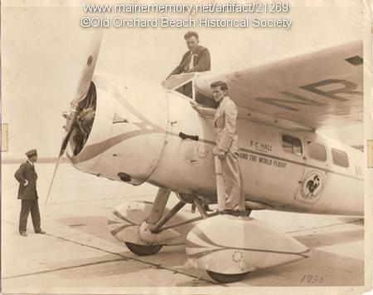
THE WINNIE MAE WAS A LOCKHEED VEGA 5B WITH A CRUISING SPEED OF 160 MPH AND A MAXIMUM SPEED OF 185MPH. IT HAD A PREFABRICATED FUSELAGE AND A WASP ENGINE WITH A POWERFUL SUPERCHARGER WHICH ENABLED THE PLANE TO REACH 16,000 FEET TO TAKE ADVANTAGE OF EAST FLOWING JET STREAM AIR CURRENTS. POST WAS ONE OF THE FIRST TO CONSIDER USING THESE TO BOOST AIR SPEED.

Slide 8
A GIANT FUEL TANK WAS INSTALLED IN THE FUSELAGE. FLIGHT INSTUMENTS WERE REGROUPED FOR EASIER READING DURING BLIND FLYING. A BANK AND TURN INDICATOR, A RATE OF CLIMB INDICATOR AND ARTIFICIAL HORIZON WERE INSTALLED WITH DUPLICATE INSTRUMENTS FOR GATTY INCLUDING AIRSPEED INDICATOR AND COMPASS AND A MASTER APERIODIC COMPASS.
GATTY PLANNED THE ROUTE ARRANGING FACILITIES AT AIRPORTS, OBTAINING METROLOGICAL INFORMATION, DETAILING FUEL NEEDS AND EMERGENCY LANDING SITES.
MAPS OF THE USSR COULD NOT BE OBTAINED AND OUTDATED BITISH WAR MINISTRY MAPS PROVED INACCURATE .
UNTIL MAY 21 THE USSR HAD REFUSED TO LET THE AVIATORS FLY OVER ITS TERRITORY BUT RELENTED ON THE BASIS OF HELP THE US GAVE SOVIET FLIERS ON THE ALASKA STAGES OF THEIR FLIGHT FROM MOSCOW IN OCTOBER 1929.

Slide 9
LEAVING ROSEVELT FIELD AT 4.55 AM ON 22 JUNE 1931, BOTH PILOTS IN SUITS NOT FLYING GEAR WITH POST $34 AND GATTY WITH $1 IN RESPECTIVE POCKETS, WINNIE MAE HEADED OUT INTO LIGHTSHOWERS.
AFTER LANDING AT HARBOUR GRACE NEWFOUNDLAND WINNIE MAE FLEW INTO THE NORTH ATLANTIC- FOG BOUND -FLYING AT 50-100 FEET TOO HEAVY TO RISE WITH NEAR FULL FUEL TANKS .POST TOOK THE PLANE TO 1600 FEET BUT FOUND NO BREAK IN THE FOG.
16 HOURS FROM NEWFOUNDLAND WINNIE MAE LANDED AT THE RAF BASE OF SEALAND NEAR LIVERPOOL.
WINNIE MAE CROSSED TO HOLLAND,REFUELLED AT HANOVER AND LANDED AT TEMPLEHOF, BERLIN FOR AN OVERNIGHT STOP.
ARRIVING IN MOSCOW THE FLIERS WERE MET BY THE USSR SOCIETY FOR AVIATION AND CHEMICAL DEFENCE. A DINNER AT THE MOSCOW SAVOY TESTED THE TIRED PAIR WITH 9 COURSES OF FOOD AND PLENTY OF VODKA TOASTS.
AIRPORT CREW IN MOSCOW PUMPED 324 IMPERIAL GALLONS OF FUEL INTO WINNIE MAE INSTEAD OF THE SMALLER US GALLONS AND THE EXTRA HAD TO BE SIPHONED OFF.

Slide 10
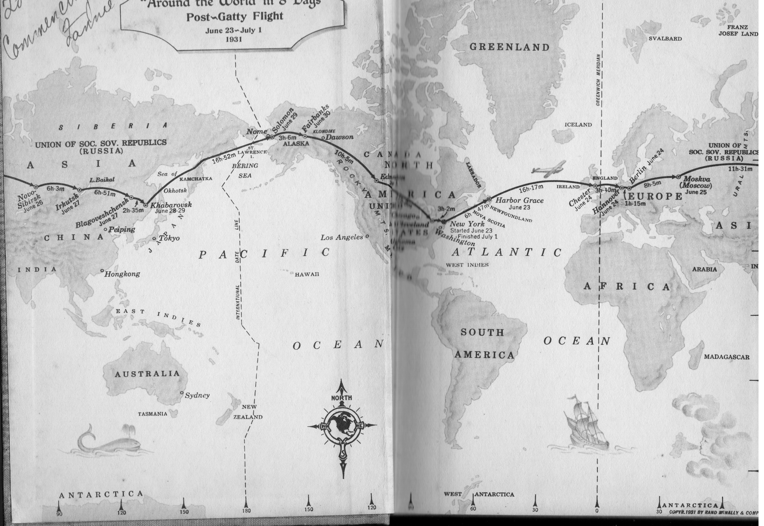
Around the World in 8 Days, Post & Gatty, Rand McNally & Co. 1931

Slide 11
FROM MOSCOW THE FLIGHT WENT TO IRKTUSK IN SIBERIA. CHECKING A BEND IN THE AMUR RIVER GATTY NAVIGATED INTO BLAGOVESHCHENK.
HERE THE AIRFIELD PROVED TO BE A MUDDY LAKE WHICH BOGGED THE WINNIE MAE.
THE NEXT DAY WATER DRAINED FROM THE RUNWAY AND HORSES AND RUSSIAN PULLING POWER EXTRACTED THE WINNIE MAE.
FOLLOWING THE TRANS-SIBERIAN RAILWAY EAST THE FLIGHT REACHED KHABAROSK . FROM HERE BOTH FLIERS ELECTED TO HEAD FOR SOLOMON ALASKA ACROSS THE PACIFIC.
THE WINNIE MAE HAD NW HEADWINDS OVER THE KAMCHATKA PENINSULA. OFF SAKHALIN ISLAND THE PLANE WAS MAKING 140 MPH.
THE LEG ACROSS THE ALEUTIAN ISLANDS AND THE BERING SEA WAS THE MOST DANGEROUS OF THE WHOLE FLIGHT. MUCH OF THIS WAS AT WAVE HEIGHT.

Slide 12
LANDING AT SOLOMON ALASKA THE PLANE REFUELLED BUT ON TAKEOFF DUG INTO SOFT SAND AND BENT TWO PROPELLER TIPS. POST FIXED THESE WITH HAMMER AND WRENCH. GATTY BRUISED HIS SHOULDER ON THE PROPELLOR IN AN ENGINE BACKFIRE BUT STILL WAS PREPARED TO NAVIGATE TO FAIRBANKS.
AT FAIRBANKS THE PROPELLOR WAS REPLACED AND WINNIE MAE REFUELLED AND THE FLIERS GOT A FEW HOURS SLEEP.
OVER CANADA THE NEXT DAY WINNIE MAE HIT RAIN AND MIST. FOLLOWING THE CANADIAN PACIFIC RAIL LINE THE FLIER REACHED EDMONTON WITH A FLOODED AIRFIELD.
A LARGE CROWD OF SPECTATORS GREETED THEM BUT THE FLIERS WERE GROSSLY WEARY AT THE OFFICIAL RECEPTION. THE WINNIE MAE WAS HAULED OUT BY A CATERPILLAR TRACTOR.
THE NEXT DAY BOTH FLIERS WERE IN HIGH SPIRITS AFTER BATHS AND SHAVES. THE PLANE TOOK OFF ON A MAIN ROAD WHERE COUNCIL CREWS HAD REMOVED TELEPHONE AND POWER CABLES .
THE LAST LEG WAS TO ROOSEVELT FIELD NEW YORK. IN THE AFTERNOON OF 30 JUNE 1931 WINNIE MAE TOUCHED DOWN THERE AFTER 8 DAYS 15 HOURS AND 53 MINUTES.

Slide 13
GATTY’ THE NEW YORK TIMES REPORTE ‘ WHOSE UNERRING NAVIGATION ENABLED THE EXPEDITION TO MAINTAIN A PERFECT SCHEDULE ON THEIR 15,474 MILE FLIGHT AROUND THE WORLD, HAULED HIMSELF UP THROUGH THE COCKPIT AND WAS SITTING, WITH A GRIN ON HIS OIL-SMEARED FACE ON THE HIGH WING OF THE SHIP WHEN THE CROWD SWARMED AROUND IT’.
GATTY AND POST WITH THEIR WIVES WERE GIVEN A SPECIAL LUNCH AT THE WHITE HOUSE WITH PRESIDENT HOOVER.
IN AUGUST 1932 AT THE NATIONAL AERONAUTIC CONVENTION GATTY RECEIVED THE DFC WITH POST FROM PRESIDENT HOOVER.
GATTY BECAME A CELEBRITY IN THE US AND ON JANUARY 15th 1932 HE WAS APPOINTED TO THE SPECIALLY CREATED CIVILIAN POSITION OF SENIOR ENGINEER IN THE AIR CORPS AND THE REQUIREMENT OF US CITIZENSHIP WAS WAIVED. GATTY FLATLY REFUSED IN ALL HIS TIME IN THE US TO CHANGE HIS AUSTRALIAN CITIZENSHIP.
FROM `1934 GATTY WAS INVOLVED IN DEVELOPING AIR ROUTES FOR TWA. HE CONCEIVED A PACIFIC ROUTE WHICH USED LAND BASED AIRCRAFT AND RAN TO AUSTRALIA FROM SAN FRANCISO TO HONOLULU, JARVIS, PAGO, PAGO SUVA, AUCKLAND TO SYDNEY. THE OTHER WOULD RUN TO JAPAN VIA HONOLULU, MIDWAY AND WAKE.

Slide 14
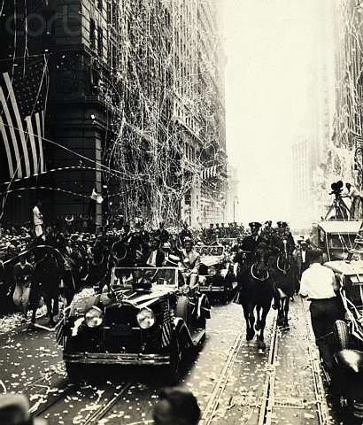

Slide 15
BACKED BY DOUGLAS, GATTY FOUND THAT KEY PACIFIC ISLANDS ON THE SAN FRANCISCO –AUCKLAND ROUTE WERE OF DOUBTFUL BRITISH CLAIMS THAT HAD BEEN COLONISED EARLIER BY US GUANO MINERS AND SO COULD BE CLAIMED BY THE US.
IT WAS THIS ACTIVITY THAT BOTH CONFLICTED WITH THE AUSTRALIAN GOVERNMENT’S PREFERENCE FOR THE IMPERIAL LONDON TO SYDNEY ROUTE AND MADE GATTY AN OUTCAST AS FAR AS CANBERRA WAS CONCERNED.
GATTY CONTRACTED WITH THE NZ GOVERNMENT IN 1935 TO DEVELOP THE PROPOSED ROUTE.
THE NZ ADMINISTRATION OF THE TIME FELT CUT OFF IN RELATION TO THE AUSTRALIAN AIR ROUTE POLICY. THE US GOVERNMENT ON ITS PART HAD DEFENCE REASONS FOR BACKING THE PAN AM ROUTE. ON 17th MARCH 1937 PAN AM’S SIKORSKY S-42 FLYING BOAT TOOK OFF FROM OAKLAND FOR ITS ARRIVAL IN AUCKLAND ON MARCH 31st.
GATTY WENT ON TO SERVE IN THE US ARMY AIR CORPS. HE WROTE “THE RAFT BOOK” IN 1944 FOR DOWNED US FLIERS IN THE PACIFIC. IT WAS BASED ON HIS EARLY INTEREST IN NATURAL NAVIGATION WHICH LATER WAS FULLY EXPLORED IN HIS BOOK “ NATURE IS YOUR GUIDE”.

Slide 16
HE MOVED TO FIJI IN 1947 AND STARTED A TUNA PROCESSING OPERATION WHICH FAILED. IN JULY 1951 HE ESTABLISHED FIJI AIRLINES AND BROUGHT IN 3 TWIN ENGINED DE HAVILLAND DH 89A’S.GATTY SERVED TWO TERMS ON FIJI’S LEGISLATIVE COUNCIL.
HE DIED NEAR NAUSORI AIRPORT AT 11 AM AUGUST 30 1957.HE WAS BURIED IN SUVA.

Slide 17
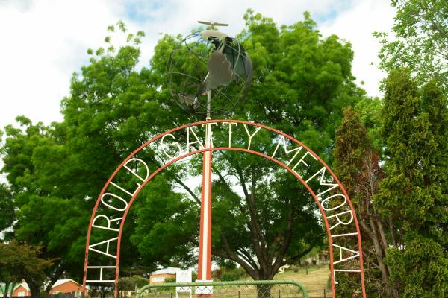
JOHN LIVERMORE
Editor: Transport:Laws of Australia
Website: www.johnlivermore.com.au
GATTY’S EPITAPH:TAMA’S PATH
The sun sags down on Tama’s path
Across the changing sky
New stars do leap across the deep
To meet the wondering eye
New seas are spread on either side
New skies are overhead
New lands await the Sea Kings
In the vast grey seas ahead

