Slide 1
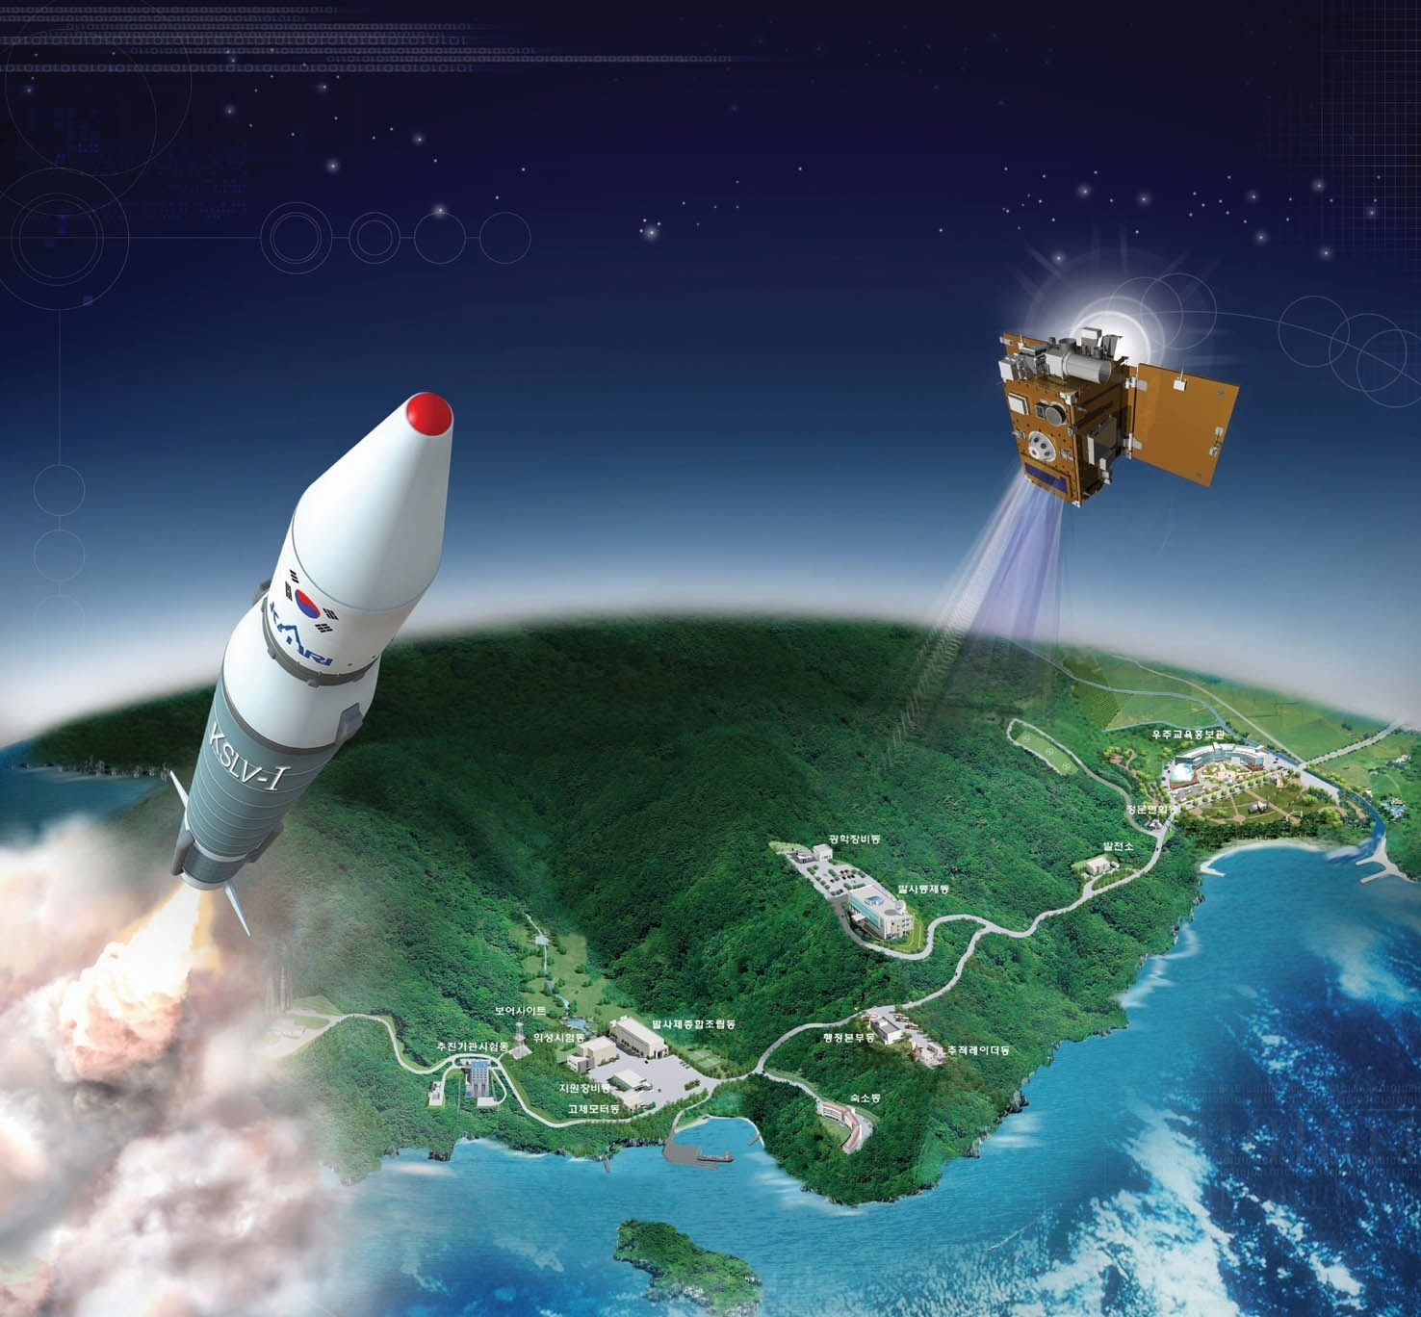
Indonesia, Malaysia Airline's Aircraft’s Accidents and Indonesian,
Chinese, Korean Aviation Law and the 1999 Montreal Convention
February, 2015
Honorary President, Korea Society of Air & Space
Law and Policy, Visiting Prof. Beijing Institute of Technology, China, Prof. Dr. Doo Hwan Kim (金斗焕)

Slide 2
Contents (目 录)
1. Indonesia AirAsia QZ8501 Jet crashed
2. Disappearance of Malaysian Airlines Flight MH 370
3. U.S. Law Firm plans to bring suit against Boeing,
Malaysia Airlines
4. The venue of the jurisdiction and compensation for
damage caused by aircraft’s accidents of Indonesia
and Malaysia Airlines
5. Air carrier’s liability under the Indonesian and
Chinese Civil Air Law
6. Air carrier’s liability under the Korean 2014 Revised
Commercial Act
7. Air Carrier’s Liability under the Montreal Convention
8. Conclusion

Slide 3
1. Indonesia AirAsia QZ8501 Jet crashed (1)
● AirAsia QZ8501 Jet departed from Juanda International Airport, Surabaya,
at 05:35 on Dec. 28, 2014 and was scheduled to arrive at Singapore
Cahangi Airport at 08:30 same day.
● The Airbus A320-200 crashed into the Java Sea on Dec. 28, 2014 carrying
162 people from Indonesia's second city Surabaya to Singapore.
● Searchers are hunting for the "black box" flight data recorders to
determine the cause of the crash.
● An initial report on the website of Indonesia's meteorological agency
BMKG suggested the weather at the time the plane went down sparked
the disaster after it appeared to fly into storm clouds.
● "Based on the available data received on the location of the aircraft's
last contact, the weather was the triggering factor behind the accident,“
said the report, which referred to infra-red satellite pictures showing
peak cloud temperatures of minus 80 to minus 85 degrees Celsius at
the time.
● Only according to a report from Indonesian meteorological expert
cause of the tragic of AirAsia flight QZ 8501 the most likely was not
turbulence (as was previously believed), but actual chunks of ice
inside the Airbus A320's engine.

Slide 4
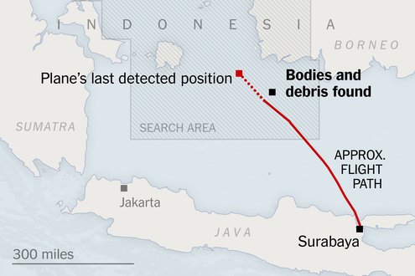
Indonesia AirAsia jet carrying 162 people lost contact with ground
controllers on Dec. 28, 2014. An Indonesia government official
confirmed that the debris was from Flight 8501. The debris was
found about 66 miles from the plane’s last detected position.
66 miles

Slide 5
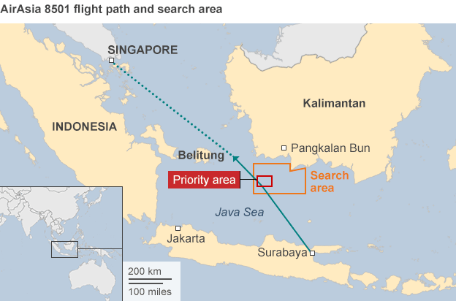
AirAsia QZ8501: Plane crash blamed on weather. Bad weather was the biggest factor in the crash of AirAsia flight QZ8501, the Indonesian
weather agency believes.
AirAsia QZ8501 were 137 adult passengers, 17 children and one infant, along with two pilots and five crew, on the plane - the majority Indonesian.

Slide 6
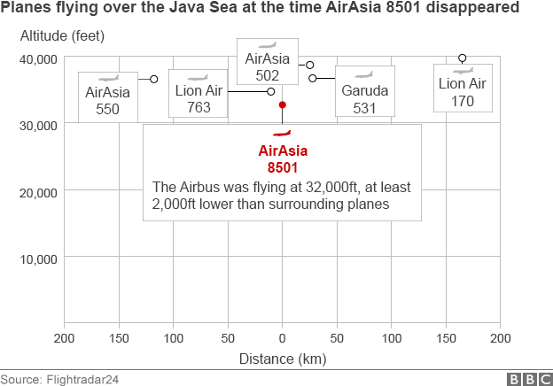
Officials said heavy air traffic in the area meant he was not given
Permission to do so straight away.
The AirAsia jet was reported to be the lowest-flying plane in the region at the time of its disappearance.
It was in an area near the equator known for thunderstorms, where trade winds from the northern and southern hemispheres intersect.
The pilot contacted air traffic control at 06:12 local time to request permission to climb to 38,000ft (11,000m) from 32,000ft to avoid big storm clouds - a common occurrence in the area.

Slide 7
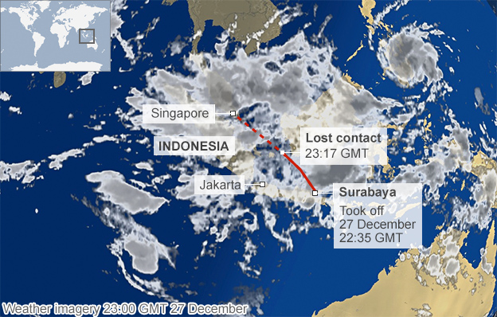
Bad Weather on the day Flight QZ8501 disappeared

Slide 8
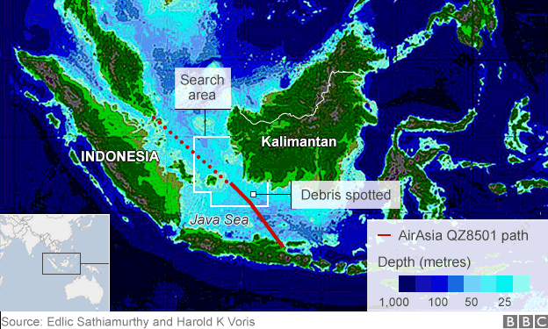
The recovery efforts, led by the Indonesian military and the Indonesian search and rescue agency, have been severely hampered by bad weather and heavy seas. About 30 vessels, including three warships, and more than 20 aircraft, including helicopters, P3 Orions, Hercules C-130s and a Russian Beriev Be-200 amphibious plane, have been involved. Australia, the US, Russia, Singapore, South Korea and China are helping with the search. Planes and ships are conducting visual and radar surveillance, as well as using sonar equipment.

Slide 9
1. Indonesia AirAsia QZ8501 Jet crashed (2)
● On board Flight QZ8501 were 155 Indonesians, three South
Koreans, and one person each from Singapore, Malaysia and
Britain. The co-pilot was French.
● About 30 ships and 21 aircraft from Indonesia, Australia, Malay-
sia, Singapore, South Korea and the United States have been
involved in the search of up to 10,000 square nautical miles.
● The plane, whose engines were made by CFM International, co-
owned by General Electric and Safran of France, lacked real-time
engine diagnostics or monitoring, a GE spokesman said.
● Such systems are mainly used on long-haul flights and can provi-
de clues to airlines and investigators when things go wrong.
● Indonesia AirAsia is 49 percent owned by Malaysia-based budget
carrier AirAsia. The AirAsia group, including affiliates in Thailand,
the Philippines and India, had not suffered a crash since its
Malaysian budget operations began in 2002.

Slide 10
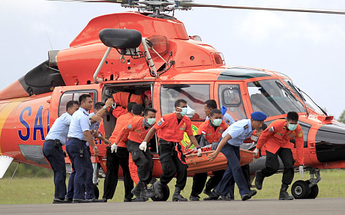
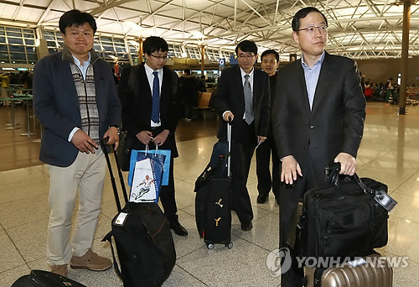
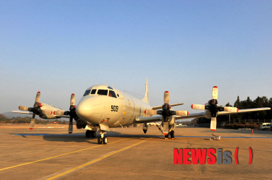
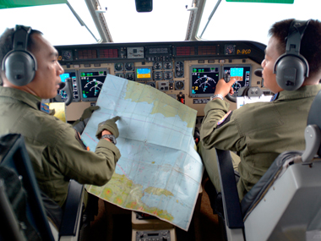
Indonesian’s Rescue Team by Helicopter
Searching of Pilots by Map
Searching of Pilots by Map
Investigate and Check Team of the Korean
Governmental Officials left Seoul for Indnesia.
South Korean’s Rescue Team by Aircraft
Searching of Pilots by Map

Slide 11
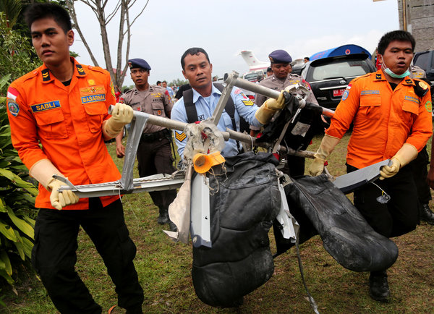
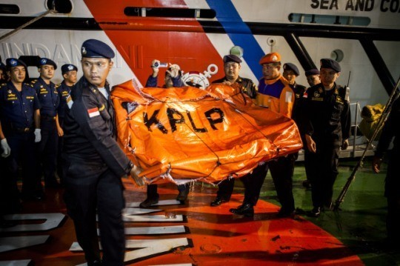
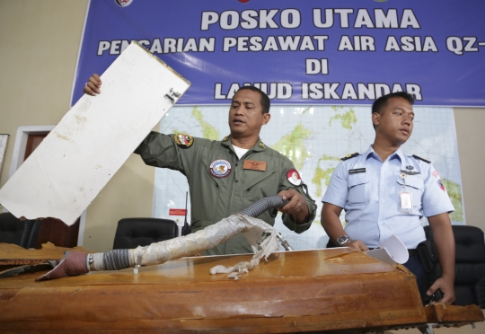
Members of a search team carried seats from AirAsia Flight 8501 on
Monday after pieces of the wreckage were airlifted to the airport in
Pangkalan Bun, Indonesia.
Entering the seventh day of search and rescue mission, the National Search and Rescue Agency (BASARNAS) Republic of Indonesia confirms that they have recovered 30 remains from the search area. The search process is still underway with the Russian SAR team joining the mission, strengthening the operation led by BASARNAS. Weather in the SAR area for tomorrow (Sunday) is forecasted to be much better with waves likely to decrease and remain at 2-3 metres.

Slide 12
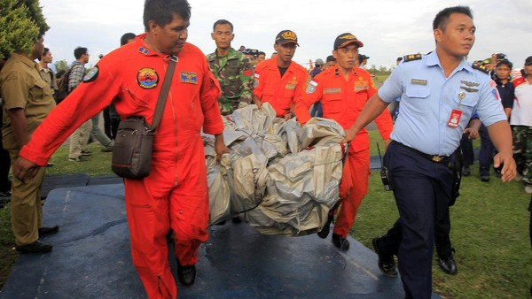
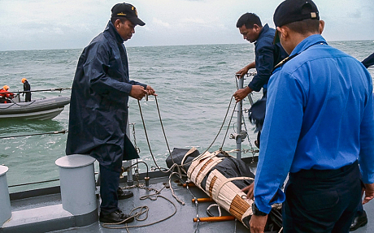
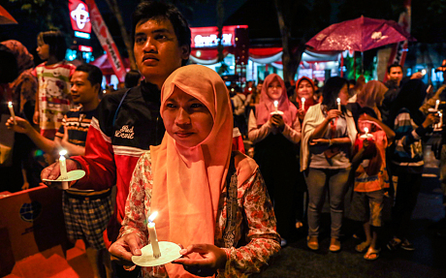
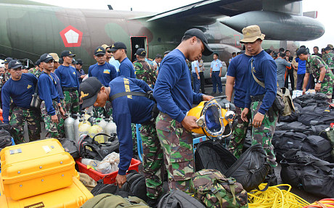
Indonesian search and rescue teams retrieved
What is believed to be an emergency slide
From the missing AirAsia plane
Royal Malaysian Navy ship KD Lekir is show here retrieving the body of a victim
Indonesians in Surabaya are holding a candle-lit
vigil for the victims of the crashed AirAsia airplane
Indonesian Navy divers inspect their gear upon arrival for the search operation for the victims of AirAsia flight QZ 8501 at the airport in Pangkalan Bun, Indonesia (AP)

Slide 13
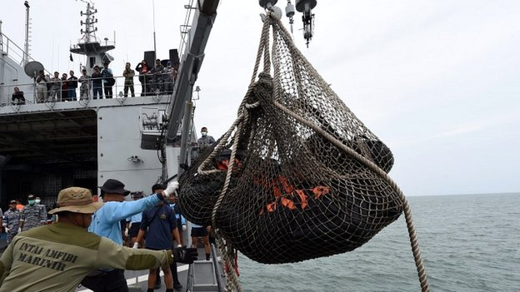
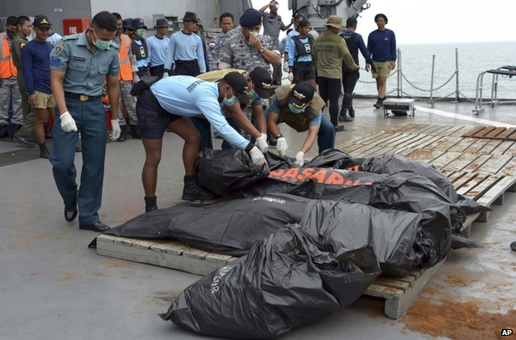
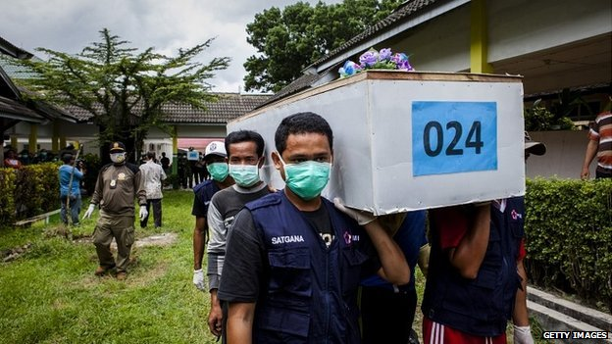
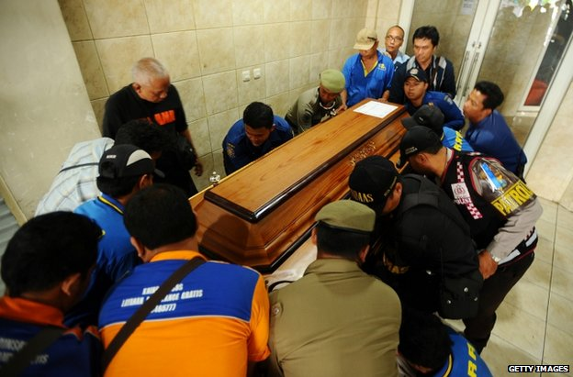
The search teams have recovered 30 bodies from
the Java Sea despite tough weather conditions
Victims in body bags were hoisted aboard a warship
Bodies of the victims are being flown back to Surabaya after being recovered from the Java Sea
Meiji Thejakusuma is one of the few victims to have been positively identified

Slide 14
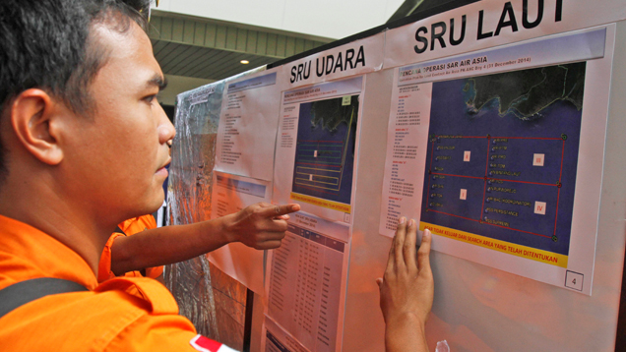
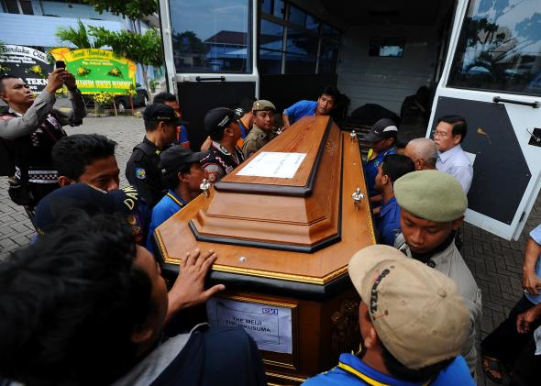
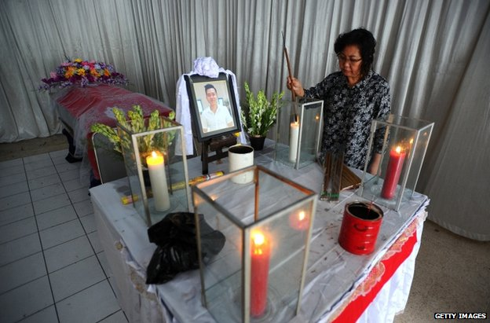
Passenger’s 37 bodies have so
far been recovered from the
155 passengers and seven
crew aboard Flight QZ 8501,
which vanished from radar 42
minutes after departing
Indonesia’s second city of
Surabaya bound for Singapore
early Dec. 28, 2014.
Meteorologists: Engine Ice Likely the " Triggering Factor" of AirAsia Crash
The mother of victim Hendra Gunawan Syawal prayed by her son's coffin in Surabaya

Slide 15
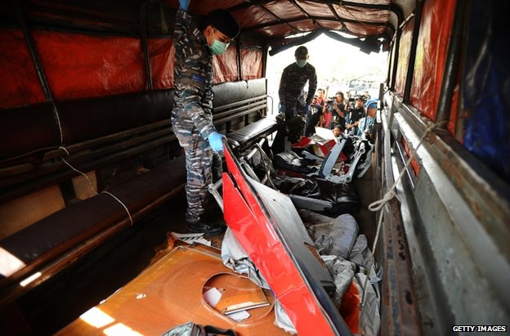
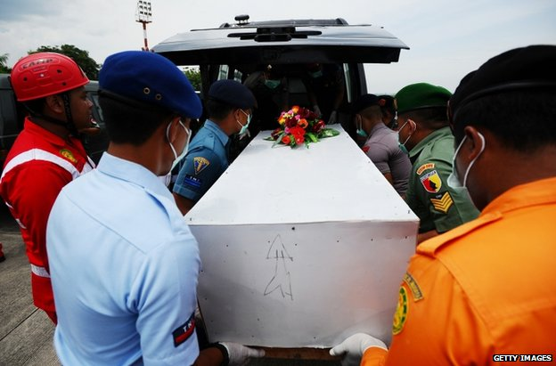
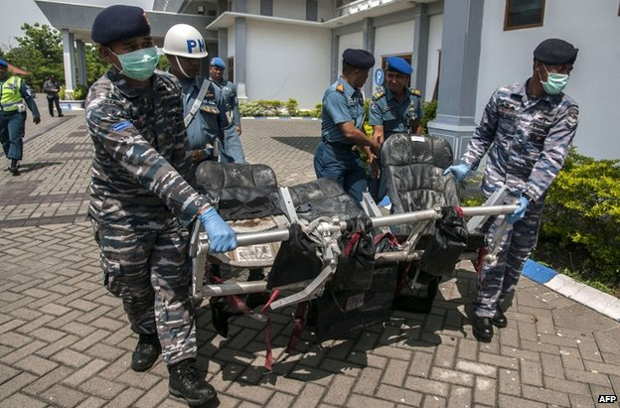
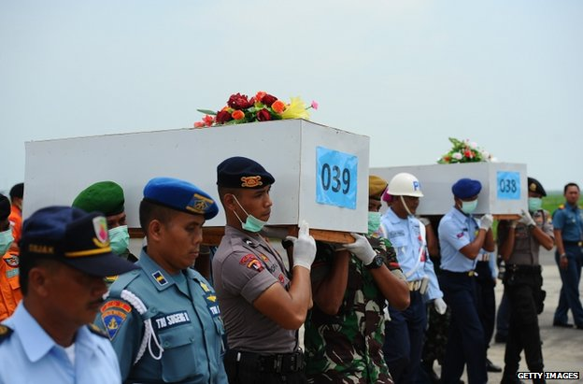
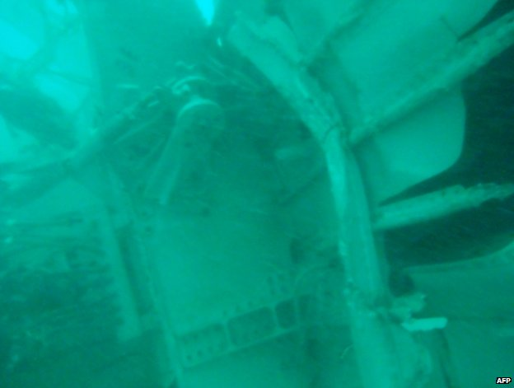
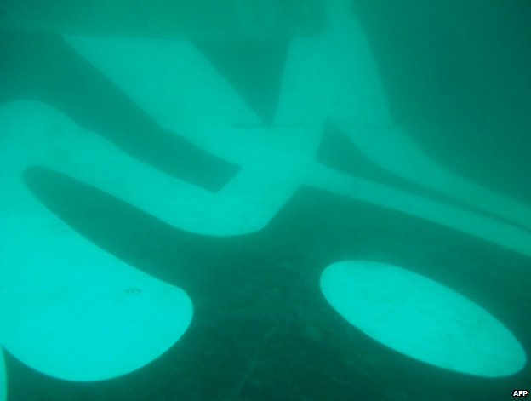
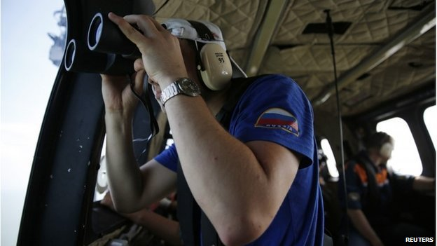
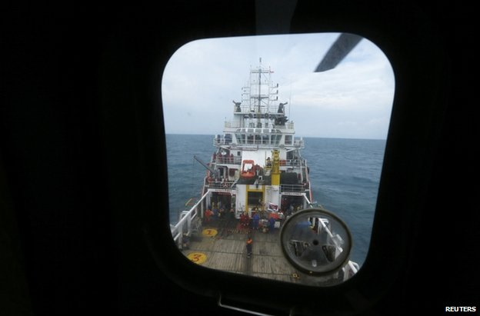
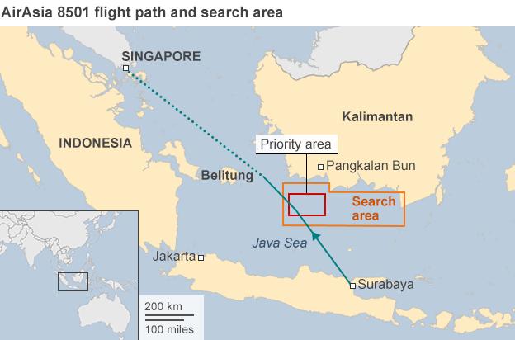
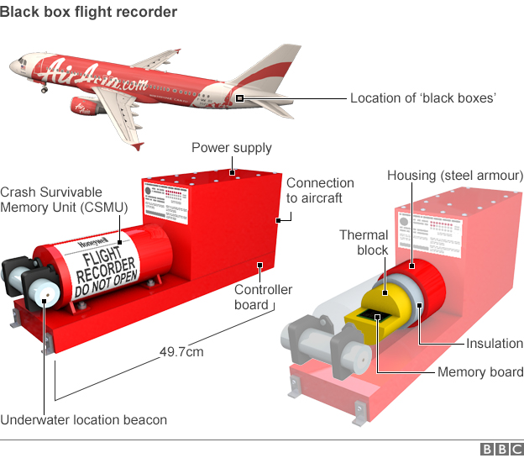
The Indonesian navy handed over air crash debris recovered so far to transport safety investigators on Jan7, 2015.
So far 41 bodies of victims have been recovered in Java Sea on Jan. 8, 2015.
Seating from the crashed plane was delivered to Surabaya on Jan.7, 2015.
The process of identifying victims continues: Indonesian personnel transfer numbered
coffins in Surabaya

Slide 16
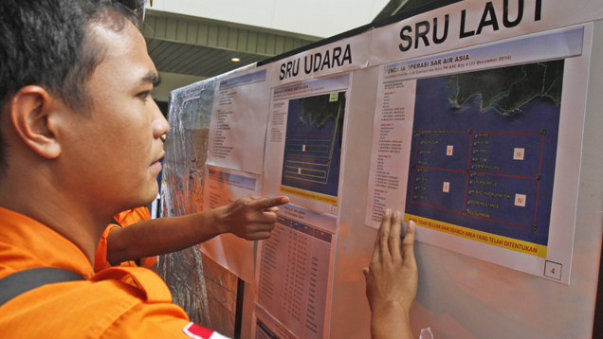
AirAsia QZ8501 Jet, Black Box Flight Recorder
The cause of the crash remains mysterious, with an experienced pilot flying a young and tested A320 aircraft into a storm before losing contact with air traffic controllers
without transmitting a distress signal.

Slide 17
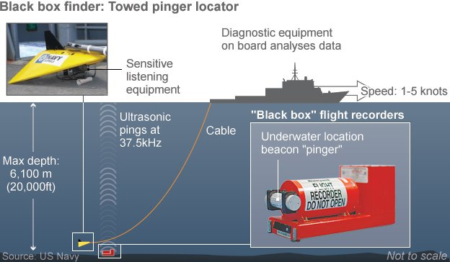
Indonesia has deployed a pinger locator to look for the plane's underwater locator beacon, which should help locate the plane's "black box" flight recorder. Civilian aircraft carry two "black boxes" - the flight data recorder and the cockpit voice recorder - each weighing about 15lb (7kg) and protected by steel casing
designed to resist water pressure in depths up to 20,000ft (6,100m).

Slide 18
2. Disappearance of Malaysian Airlines Flight MH 370 (1)
● The Malaysia Airlines Flight 370 departed from Kuala Lumpur
International Airport on March 8,2014 at 00:41 local time and was
scheduled to land at Beijing Capital International Airport at 06:30
local time.
● The Malaysia Airlines also marketed as China Southern Airlines
(中国南方航空公司) Flight 748 (CZ748) through a code-share
agreement, was a scheduled international passenger flight that
disappeared on 8 March 2014 en route from Kuala Lumpur Inter-
national Airport to Beijing Capital International Airport (a distance
of 2,743 miles : 4,414 km).
● The aircraft, a Boeing 777-200ER last made contact with air traffic
control less than an hour after takeoff.
● Operated by Malaysia Airlines (MAS), the aircraft carried 12 crew
members and 227 passengers from 15 nations.
● There were 227 passengers, including 153 Chinese and 38
Malaysians, according to the manifest. Nearly two-thirds of the
passengers on Flight 370 were from China. Seven were children.
● Other passengers came from Indonesia 7, Australia 6, India 5,
France 4, USA 3, Iran 2, Canada 2, New Zealand 2, Ukraine 2,
Canada 2, Russia 1, The Netherlands and Taipei.

Slide 19
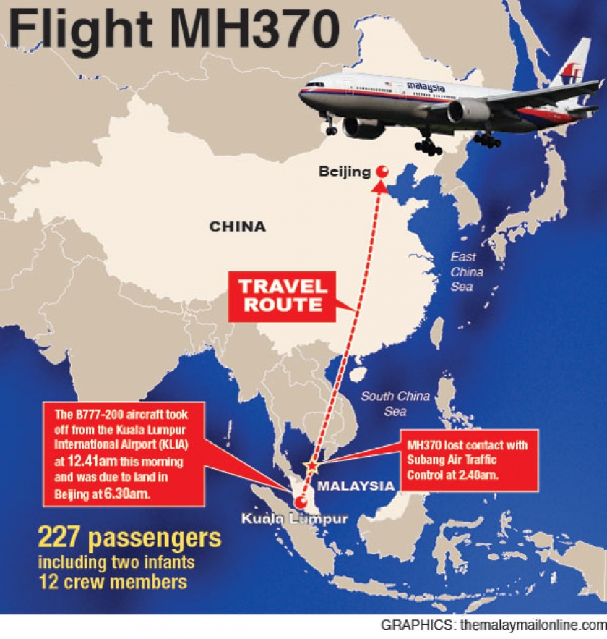
The flight MH370, a Malaysia Airlines Boeing 777, enroute from Kuala Lumpur to Beijing, lost contact with air traffic control about 2 hours after take off.
The missing flight carried 227 passengers-153 from China, 38 from Malaysia, 7 from Indonesia & Australia, 5 from India, 4 from US.There were 12 crew members.

Slide 20
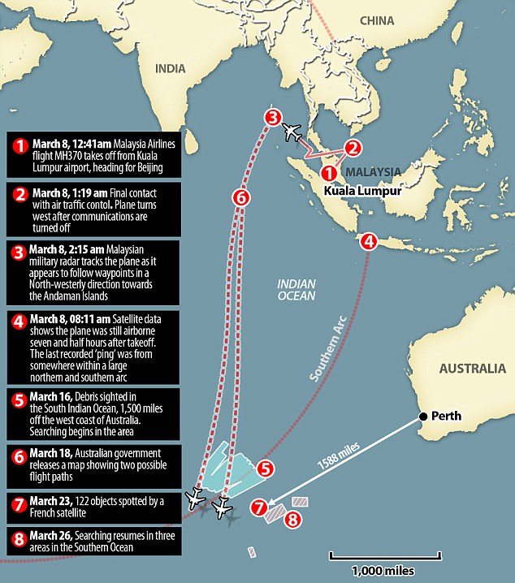
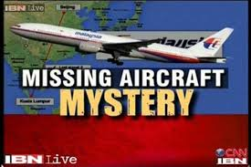
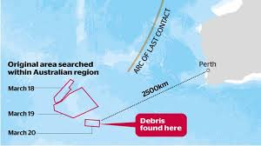
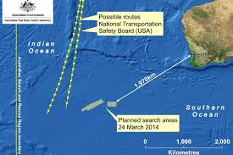
1. Disappearance of Malaysian Airlines Flight MH 370 (2)

Slide 21
2. Disappearance of Malaysian Airlines Flight MH 370 (3)
● On 24 March, 2014, the Malaysian government confirmed analyses by the
AAIB and Inmarsat satellite which concluded "beyond any reasonable
doubt" that the aircraft had gone down in the southern Indian Ocean with
no survivors.
● Since 22 March, 2014, there have been almost daily sightings of marine
debris in the search area made by various countries' satellites.
● 媒体声明二十七, 发布者：马来西亚航空公司总裁 阿末佐哈里
发布时间：2014年3月30日 下午3点45分
在这里，马来西亚航空公司想要澄清：当权威机构确认残骸实体为MH370航班后，
我们才会安排失事乘客家属前往澳大利亚珀斯。
一旦相关政府机构为家属提供了前往澳大利亚的入境许可，马来西亚航空公司将在
第一时间将他们送往失事飞机残骸的放置地点。
● 我们将在澳大利亚珀斯成立家属援助中心(Family Assistance Center）。
马来西亚航空公司全力支持相关外国政府在搜寻航班及打捞残骸方面所做出的努力，
并且我们将继续与参与此次事件调查的各权威机构保持合作关系。
另外，来西亚航空公司还将一如既往的为所有失事乘客家属提供补助和支持。

Slide 22
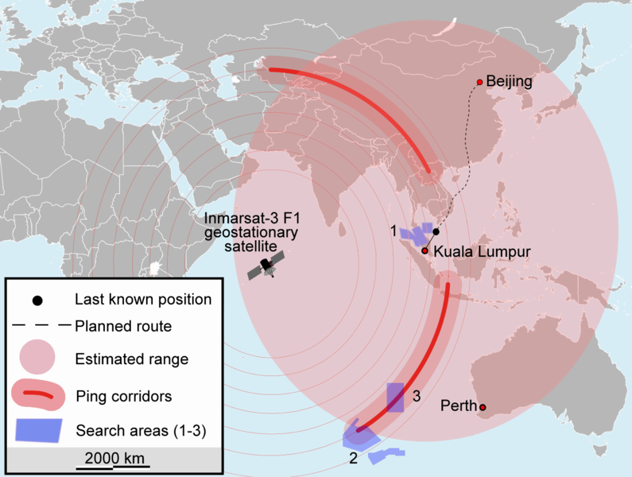
2. Disappearance of Malaysian Airlines Flight MH 370 (4)

Slide 23
2. Disappearance of Malaysian Airlines Flight MH 370 (6)
● Two Iranian men were found to be travelling on false passports.
But further investigation revealed two Iranian were headed for
Europe via Beijing, and had no apparent links to terrorist groups.
● Among the Chinese nationals was a delegation of 19 prominent
artists who had attended an exhibition in Kuala Lumpur.
● On the day that contact with the aircraft was lost, a joint search
and rescue effort, later reported as the largest in history, was
initiated in the Gulf of Thailand and the South China Sea.
● The search area was later extended to include the Strait of
Malacca, Andaman Sea, and the Indian Ocean.
● Two satellite images taken on 16 March and 18 March 2014
showed potential aircraft debris in the southern Indian Ocean
southwest of Western Australia, prompting increased search
activity in the area.
● Malaysian Prime Minister N. Razak said that the Inmarsat and Air
Accidents Investigation Branch (AAIB) have concluded that
Malaysia Airlines MH370 flew along the southern corridor, and
that its last position was in the middle of the Indian Ocean, west
of Perth.

Slide 24
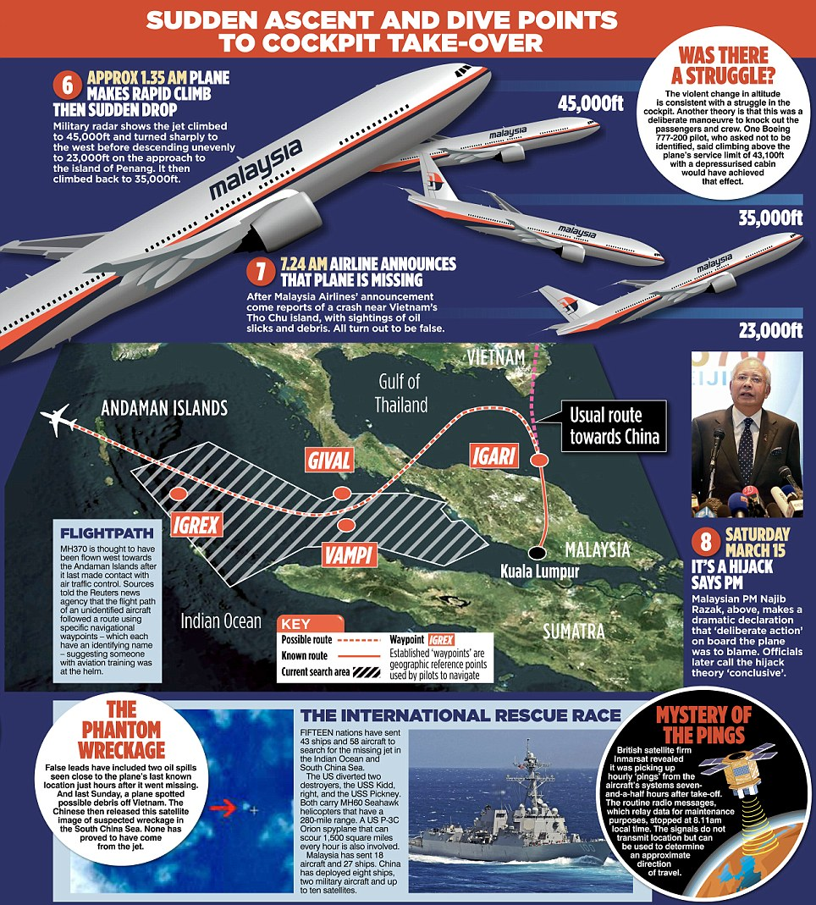
The International Rescue Race
The 15 nations have sent 43 ships and 58 aircraft to search for the missing airplane in the Indian Ocean and South China Sea. Malaysia has sent 18 aircraft and 27 ships . China has deployed 8 ships and 2 military aircraft and up to 10 satellites.
British satellites firm Inmarsat revealed it was picking up hourly ‘pings’ from the aircraft’s systems 7 hours and a half hours after take off.

Slide 25
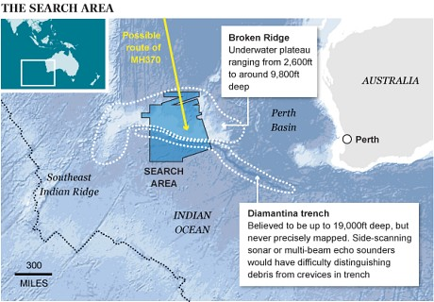
2. Disappearance of Malaysian Airlines Flight MH 370 (7)

Slide 26
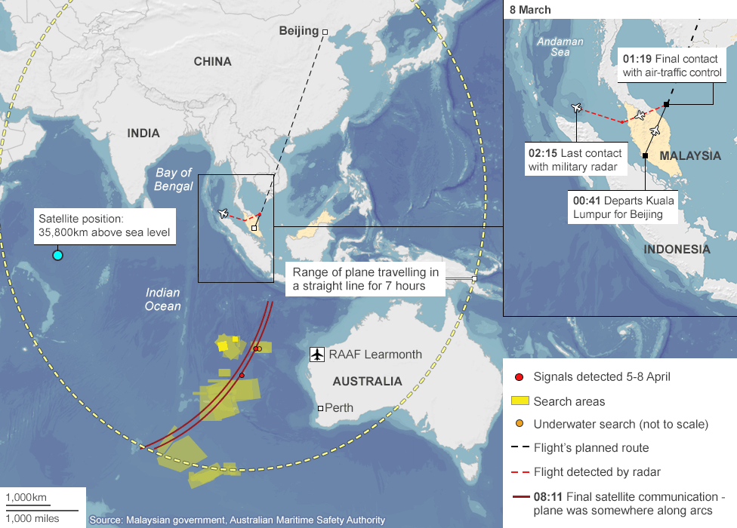
2. Disappearance of Malaysian Airlines Flight MH 370 (8)

Slide 27
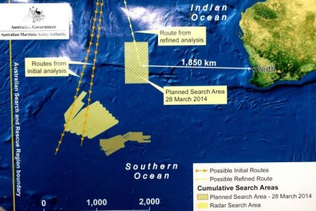
2. Disappearance of Malaysian Airlines Flight MH 370 (9)

Slide 28
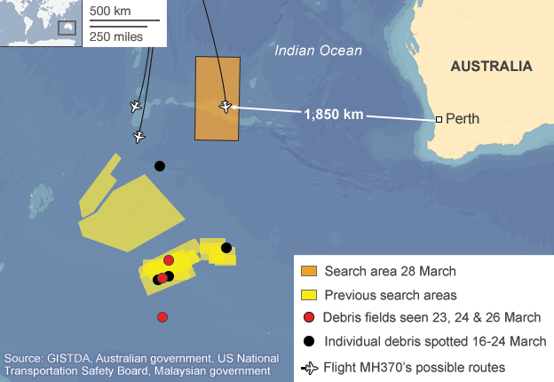
2. Disappearance of Malaysian Airlines Flight MH 370 (10)

Slide 29
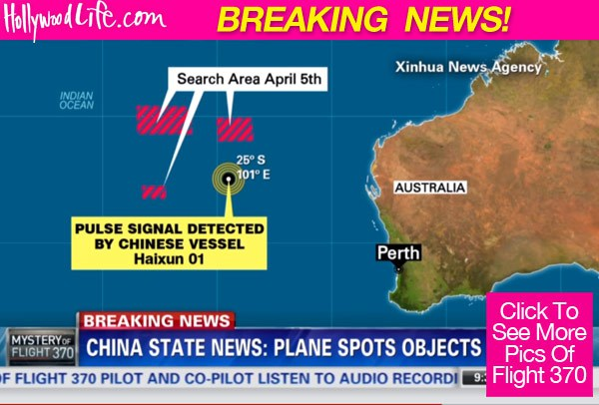
On April 5, 2014 what could be the wreckage of ill-fated Malaysia Airlines Flight MH370 has been spotted drifting in a remote section of the Indian Ocean. According to reports, the debris was spotted after
Investigators discovered an electronic pulse in the same area.
A Chinese ship traveling within the search area inside the Indian Ocean discovered what has been described as a “series of sounds.” Just 56 miles away, the ship also spotted debris they described as white objects floating in the water.

Slide 30




2. Disappearance of Malaysian Airlines Flight MH 370 (12)
Press Interview

Slide 31
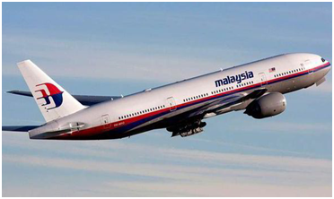
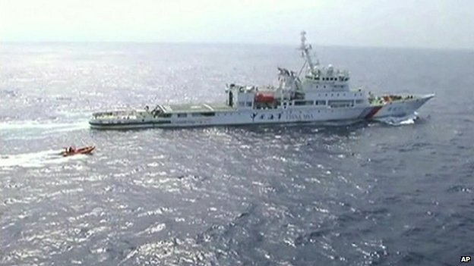


4. Disappearance of Malaysian Airlines Flight MH 370 (13)
An unmanned submarine has completed its first
search for debris from missing Malaysia Airlines
flight MH370 in the southern Indian Ocean.
Chinese patrol ship Haixun 01 is pictured during
a search for the missing Malaysia Airlines flight MH370, in the south Indian Ocean April 5, 2014.

Slide 32

4. Disappearance of Malaysian Airlines Flight MH 370 (14)
Passengers 237+Crew 12=239
Country | Persons
Australia | 6
Canada | 2
China (Hong Kong) | 1
China (Mainland) | 152
France | 4
India | 5
Indonesia | 7
Iran | 2
Malaysia | 38
Netherlands | 1
New Zealand | 2
Russia | 1
Taipei | 1
Ukraine | 2
The United States | 3
Total | 239

Slide 33

2. Disappearance of Malaysian Airlines Flight MH 370 (15)

Slide 34

Relatives of passengers on the missing flight march to the Malaysian embassy in Beijing.

Slide 35
3. U.S. Law Firm plans to bring suit against Boeing, Malaysia Airlines (1)
● A U.S.-based Law Firm said it expects to represent families of more than
half of the passengers on board the missing Malaysian Airlines flight in a
lawsuit against the carriers and Boeing Company, alleging the plane had
crashed due to mechanical failure.
● The Beijing-bound flight MH370 disappeared more than few weeks ago,
and was announced to have crashed into the remote southern Indian
ocean with all 239 on board presumed to have died.
● Chicago-based Ribbeck Law has filed a petition for discovery against
Boeing Co., manufacturer of the aircraft, and Malaysian Airlines operator
of the plane in a Cook County, Illinois Circuit Court in the United States.
● The petition is meant to secure evidence of possible design and Manufa-
cturing defects that may have contributed to the disaster, the Law Firm
said.
● Though both Boeing and Malaysian Airlines were named in the filing, the
focus of the case will be on Boeing, Ribbeck's lawyers told reporters, as
they believe that the incident was caused by mechanical failure.

Slide 36
● "Our theory of the case is that there was a failure of the equipment in the
cockpit that may have caused a fire that rendered the crew unconscious, or
perhaps because of the defects in the fuselage which had been reported
before there was some loss in the cabin pressure that also made the pilot
and co-pilot unconscious," Monica Kelly, head of Global Aviation Litigation
at Ribbeck Law, told reporters.
● "That plane was actually a ghost plane for several hours until it ran out of
fuel."
● Kelly said the conclusion was made based on experience on previous
incidents, dismissing the possibilities of hijacking or pilot suicide.
● The lawsuit, soon to be filed, would seek millions of dollars of compensati-
on for each passenger and ask Boeing to repair its entire 777 fleet.
● The Law Firm said it expected to represent families of more than 50 perce-
nt of the passengers on board the flight, but declined to give details on
how many families have sought their representation in the case.
● A spokesman for Malaysian Airlines could not immediately be reached for
comment.
3. U.S. Law Firm plans to bring suit against Boeing, Malaysia Airlines (2)

Slide 37
3. U.S. Law Firm plans to bring suit against Boeing, Malaysia Airlines (3)
● Aircraft manufactures(飞机制造業者) may be liable for the violation of
duty as manufactures in general.
2. U.S. Law Firm plans to bring suit against Boeing, Malaysia Airlines
● Thus they may be liable for their negligence, they may be behold to strict
liability in tort, and they may be liable for breach of express or implied
warranties.
● Product liability (制造物责任) is the area of law in which manufacturers,
vendors, and others who make products available to the public are held
responsible for the injuries those products cause.
● Regulation of product liability on a national level have been devised in a
number of countries including the UK, EU, Germany, France, China (中国
制品 品质法) etc, like the Model Uniform Liability Act in the United States
of America.

Slide 38
3. U.S. Law Firm plans to bring suit against Boeing and Malaysia Airlines (4)
● In Korea (韩国 )product liability (PL) is regulated by the Product Liability
Act (制造物责任法), which was enacted in 2000 and then revised on May
22, 2013.
● It was enacted against strong opposition of business community to protect
consumers from injury and damage caused by defective products based on
strict liability, and to enhance the safety standards of products, thereby
contributing to the competitiveness of manufacturers.
● A manufacturer shall be liable for loss of life, injury or other damages
caused by defective products (Article 3, 1).
● When more than two persons are liable for the same damage, they shall
bear joint and several liability like tort liability based on the Civil Act
( Article 5) in Korea.

Slide 39

Two Malaysian boys sue airline, government in first case after MH370′s mysteriously disappeared eight month ago (5)
Malaysian lawyer Arunan Selvaraj, center, speaks to
journalists outside a courthouse in Kuala Lumpur,
Malaysia.
Two Malaysian teenage boys sued Malaysia Airlines and
the government over the loss of their father on Flight
370 on Oct. 31, 2014, the first lawsuit filed by the family
of a passenger of the jetliner that mysteriously
disappeared eight months ago.
Jee Kinson, 13, and Jee Kinland, 11, accused the civil aviation department
of negligence for failing to try and contact the plane within a reasonable
time after it disappeared from radar while flying from Kuala Lumpur to
Beijing on March 8 with 239 people on board.
The suit filed at the Kuala Lumpur High Court alleges the airline was negligent and failed to take all due measures to ensure a safe flight.
They committed gross neglect and breach of duty.
"We have waited for eight months. A big plane missing in this age of technology is really unacceptable," their lawyer Arunan Selvaraj said.
The boys are seeking damages for mental distress, emotional pain and
the loss of support following the disappearance of their father.
● Steve Wang, a Chinese man whose mother was on the plane, said many
Chinese families had retained lawyers but he didn't think any of them
had filed a lawsuit yet.

Slide 40
4. The venue of the jurisdiction and amount of compensation for damage
caused by aircraft’s accidents of Indonesia and Malaysia Airlines (1)
1) Venue of the jurisdiction for the Indonesia and Malaysia Airline’s case
● As South Korea, China, Indonesia, Malaysia and the USA are party states of
1999 Montreal Convention, so the case of the Indonesia and Malaysia Airline
case will be applied by the Article 33 (Jurisdiction) of the 1999 Montreal
Convention as the following.
Article 33－Jurisdiction (第33条 - 裁判管辖权)
1. An action for damages must be brought, at the option of the plaintiff, in
the territory of one of the States Parties, either before
① the court of the domicile of the air carrier or of
② its principal place of business (airlines), or
③ where it has a place of business through which the contract has
been made or
④ before the court at the place of destination.
2. In respect of damage resulting from the death or injury of a passenger,
an action may be brought before one of the courts mentioned in
paragraph 1 of this Article, or in the territory of a State Party in which
at the time of the accident the passenger has
⑤ his or her principal and permanent residence.
● Chinese, Korean, Indonesian, Malaysian & USA victims may raise a lawsuit
relating to the compensation for damage at the said option’s five venue
of jurisdiction by the victims to the Chinese, Indonesian and the US court.

Slide 41
● Though the United States had adopted the limited liability system
for air carrier’s liability in the international flight based on the
1999 Montreal Convention, but the United States had been adopted
the unlimited liability systems for air carrier’s liability in the
domestic flight in order to protect American passengers.
● Already in 1971 at the Guatemala City Diplomatic Conference the
US delegation insisted on the inclusion of the 5th jurisdiction-the
place of residence of the claimant.
● The delegations realized at that time that the consequence of this
proposal was that every US claimant will be able to establish the
jurisdiction within the US whose Courts were known for awarding
compensations far in excess of the awards common in other
countries.
● During the preparatory work on the Montreal Convention and at
the opening of the Diplomatic Conference the US delegation made
clear it belief that including the fifth jurisdiction in any new
convention.
4. The venue of the jurisdiction and amount of compensation for damage
caused by aircraft’s accidents of Indonesia and Malaysia Airlines (2)

Slide 42
4. The venue of the jurisdiction and amount of compensation for damage
caused by aircraft’s accidents of Indonesia and Malaysia Airlines (3)
● The question of the 5th jurisdiction thus became a non-negotiable
issue and the ICAO Diplomatic Conference gradually rallied to it.
● The introduction of the 5th jurisdiction in Article 33 paragraph 2 of
the Montreal Convention hardly deserves much theoretical attention
and is in no way revolutionary.
● Under most legal systems the claimant can always bring an action
in the place of his principal and permanent residence if the
opponent has some (commercial) presence in the same place.
● In fact Article 28 of the Warsaw Convention was needlessly depriving
the claimant of this logical jurisdiction.
● However, the acceptance of the 5th jurisdiction is a diplomatic
victory for the US and it can be realistically expected that claimants’
lawyers will use every opportunity to file the claim in the US
jurisdiction.
● In the long run it will be the consumer who will pay for high
insurance costs for such increased risk exposure.

Slide 43
4. The venue of the jurisdiction and amount of compensation for damage
caused by aircraft’s accidents of Indonesia and Malaysia Airlines (4)
● The amount of compensation for damage caused by MA aircraft accident
● The Indonesia and Malaysia Airline must pay to the families and victims
of those on board around 113,100 SDR ($175,000) under a multilateral
treaty known as the 1999 Montreal Convention.
● Compensation for loss of life is vastly different between U.S. passengers
and non-U.S. passengers. "If the claim is brought in the U.S. courts, it's
of significantly more value than if it's brought into any other court.”
● And for U.S. citizens there is no problem getting into the U.S. court
● There were passengers of 15 different nationalities on board the
flight, Malaysia Airlines said, with the majority – 152 – Chinese.
● There were also 38 passengers from Malaysia, seven were Indones-
ian, six were from Australian and three Americans were on board,
among other nationalities.
● American lawyer Ms. Rolfe estimated that an American court could
pay out between $8-10 million on a per-passenger basis, but
compensation would be a fraction of this outside of the U.S.

Slide 44




4. UN International Monetary Fund (国际货币基金组织) (5)
January 9, 2015, Exchange Rate of 1 SDR→ Price of Unit of Account→US $ 1.43
1 SDR = 18,064 Rupiah. 8,76 Chinese Yuan, 1,569 Korean Won,
IMF Website: http://www.imf.org
The SDR is an international reserve asset,
created by the IMF in 1969 to supplement its
member countries' official reserves.
The currency value of the SDR is determined by
summing the values in U.S. dollars, based on
market exchange rates, of a basket of major
currencies (the U.S. dollar, Euro, Japanese yen,
and pound sterling). The SDR currency value is
calculated daily and the valuation basket is
reviewed and adjusted every five years.
IMF 本部 : Washington D.C.
IMF Membership: 187 States
July 5, 2011, Inauguration
IMF Governor (France)
Ms. Christine Lagarde

Slide 45
4. The venue of the jurisdiction and amount of compensation for damage
caused by aircraft’s accidents of Indonesia and Malaysia Airlines (6)
As there were 227 passengers on board MH370, which vanished on March 8 and is believed to have plunged in the southern Indian Ocean based on latest satellite analysis from Britain, Malaysia Airlines' liability could come close to US$40 million.
But if an airline is found to be guilty of negligence, its liability can be much
higher, says the Bloomberg report.
The cap of about US$175,000 in damages per passenger as stipulate in
the treaty may no longer apply in this scenario, as family member of the affected passengers may sue and demand much higher compensation.
The carrier said it has “adequate insurance coverage in place to meet all
reasonable costs” of the disaster, including assisting families amid the
search. Malaysia Airlines has already made financial-assistance offers to
families of about US$5,000 each.
Survivors’ best chance for seeking more would be to find a way to sue in
the U.S., where awards and settlements can be more generous than in the
two Asian countries.

Slide 46
5. Air carrier’s liability under the Indonesian and
Chinese Civil Aviation Law (1)
Indonesia Aviation Law of 2009 (1)
● Any carrier shall be liable for indemnity for death of passengers,
permanent defects, or injuries caused by incidents on board
the aircraft and/or while getting on or off the aircraft.
● Any beneficiary/next of kin of the victim or the victim suffered
due to air transportation incident as meant in loss shall submit
a law suit to the court in order to get additional compensation
other than the pre-determined compensation for losses (Article
141).
● Any carrier shall be liable for any losses suffered by any passen-
ger due to loss, destruction, or damage of any checked-in bagga-
ge as a result of air transportation activities while the checked-
in baggage is under supervision of the carrier (Article 144).
● Any carrier shall be liable for damages/losses suffered by any
cargo shipper for losses, destruction, or damages of cargo caused
by any air transportation activity while the cargo is under super-
vision of the carrier (Article 145).

Slide 47
5. Air carrier’s liability under the Indonesian and
Chinese Civil Aviation Law (2)
Indonesia Aviation Law of 2009 (2)
● Any carrier shall be liable for losses incurred due to any delay of
the transportation of passengers, baggage, or cargo, except
when the carrier can prove that the delay is caused by weather
and operational technical factors (Article 146).
● The amount of indemnity for each passenger who died, perma-
nently disabled, bodily injured shall be stipulated under a Mini-
sterial Regulation (Article 165, 1).
● The right to file law suit for damages suffered by a passenger or
shipper against the carrier shall be declared expired after a
period of 2 (two) years from the date the cargo and the baggage
should have arrived at the place of destination (Article 177).
● Passengers who are in a lost aircraft, shall be considered dead,
if within 3 months after the date the aircraft is supposed to land
at the final destination there is no news of the passengers conc-
erned, without any court decision being needed (Article 178, 1)

Slide 48
5. Air carrier’s liability under the Indonesian and
Chinese Civil Aviation Law (3)
(2) The rights to receive compensation may be claimed after a period of 3
(three) months has been passed
Indonesia Aviation Law of 2009 (3)
● The rights to receive compensation may be claimed after a
period of 3 months has been passed. (Article 178, 2).
● Air carriers shall be obligated to insure their liabilities towards
passengers and cargo they are transporting. (Article 181).
● Anybody who is operating an aircraft shall be responsible for
damages/loss suffered by a third party as a result of the aircraft
operation, aircraft accident, or falling down of other objects from
the aircraft being operated.
● The compensation/indemnity on damages/loss suffered by a
third party as meant in item (1) shall be given in accordance
with the actual damages/loss suffered.

Slide 49
5. Air carrier’s liability under the Indonesian and
Chinese Civil Aviation Law (2)
● I would like to introduce briefly an air carrier’s liability under the civil
aviation law of the People’s Republic of China (PRC) adopted in 1995 is
the fundamental law in the area of civil aviation.
● The Chinese Civil Aviation Law (中国民用航空法)
Article 124~129 of the Chinese Civil Aviation Law,
Section 3 Liability of the Carrier (第三节 承运人的责任)
● Article 124, The carrier shall be liable for the death or personal injury of
a passenger, if the accident took place on board the civil aircraft or in
the course of any of the operations of embarking on or disembarking
from the civil aircraft; provided that the carrier is not liable if the death
or injury resulted solely from the state of health of the passenger.
[Example of Legislation: 立法例]
Article 17 of the 1929 Warsaw Convention, Article 21 of the 1999
Montreal Convention, Article 45 of 2012 德国修订航空运送法 , 904~912
of 韩国修订商法, Article 124~129 of 中国民用航空法

Slide 50
5. Air carrier’s liability under the Indonesian and
Chinese Civil Aviation Law (3)
● 中国民用航空法
Article 129. In international air transport, the liability of the carrier
shall be as the following:
(1) The liability of the carrier for each passenger is limited to the
sum of 16,600 units of account. Nevertheless, the passenger
may agree with the carrier in writing to a limit of liability higher
than that prescribed by this sub-paragraph,
(2) The liability of the carrier for each kilogram of checked baggage
or cargo is limited to a sum of 17 units of account.
(3) The liability of the carrier for carry-on baggage of a passenger
is limited to 332 units of account per passenger.
第一百二十九条 国际航空运输承运人的赔偿责任限额按照下列规定执行：
(一) 对每名旅客的赔偿责任限额为16600计算单位；但是，旅客可以同承运人书面
约定高于本项规定的赔偿责任限额
(二) 对托运行李或者货物的赔偿责任限额，每公斤为17计算单位.。
(三) 对每名旅客随身携带的物品的赔偿责任限额为332计算单位.

Slide 51
5. Air carrier’s liability under Indonesian and the
Chinese Civil Aviation Law (4)
● 中国民用航空法 第一百二十九条 (二)(航空貨物承运人的责任)
Article 129. (2) The liability of the carrier for each kilogram of
checked baggage or cargo is limited to a sum of 17 units of account.
If the passenger or shipper has made, at the time when the package
was handed over to the carrier, a special declaration of interest in
delivery at destination and has paid a supplementary sum if the
case so requires, the carrier shall be liable to pay a sum not excee-
ding the declared sum, unless he proves that the sum declared by
the passenger or shipper is greater than the actual interest of the
checked baggage or cargo in delivery at destination.
第一百二十九条 (二)对托运行李或者货物的赔偿责任限额, 每公斤为17计算单位.
旅客或者托运人在交运托运行李或者货物时, 特别声明在目的地点交付时的利益,
并在必要时支付附加费的, 除承运人证明旅客或者托运人声明的金额高于托运行李
或者货物在目的地点交付时的实际利益外, 承运人应当在声明金额范围内承担责任.
[Example of Legislation: 立法例]
Article 7 of the 1975 Montreal Protocol, Article 21~23 of the 1999
Montreal Convention, Article 47, 4 of 德国修订航空运送法

Slide 52
Comparison between Chinese and the Korean Air Transport Law on
the Limited Sum of the Compensation for Damage of the Air Carrier
Civil Aviation Law (CAL) in China (中华人民共和国民用航空法) 2009年8月27号, 修订 | Air Law in the Korean Commercial Code (韩国商法典里航空承运法) 2014年5月20号, 修订
16,600 Unit of Account: Death or Injury, Per Passenger, Article 129 (1) of the CAL | 113,100 Unit of Account, Death or Injury, Per Passenger, Article 905 of the KRCC
17 Unit of Account: Destruction, Loss, Damage/Delay of Cargo, Per 1kg Article 129 (2) of the CAL | 19 Unit of Account, Destruction, Loss, Damage/Delay of Cargo, Per 1kg, Article 915 of the KRCC
332 Unit of Account: The Limited Indemnity of Checked Baggage, Per Passenger, Article 910 of the KRCC | 1,131 Unit of Account: The Limited Indemnity of Checked Baggage, Per Passenger, Article 910 of the KRCC
 | 4,694 Unit of Account, Indemnity, Delay, Per Passenger, Article 907, 2 of the KRCC, Provided that, Domestic Flight, Per Passenger, 1,000 Unit of Account

Slide 53
6. Air carrier’s liability under the Korean Revised Commercial Act (1)
● The Korean Revised Commercial Act
Liability and limited sum of compensation for passenger’s damage
of air carrier (航空乘客运送人的责任和损害赔偿限度额: Article 904~907
of the Korean Revised Commercial Act)
(1) With respect to damage sustained in cases of death or bodily injury of
a passenger, a carrier shall be liable only when an event that caused
damage took place on board the aircraft or in the course of any of the
operations of embarking or disembarking.
(2) For damages in the case of death or bodily injury of passenger
caused by the aircraft accidents, air carrier is then burdened the
strict liability until 113,100 unit of account per passenger, in
excess of 113,100 unit of account for the damages of the bodily
injury or death of passengers that occurred in the accident aircraft,
the KRC Act adopted the principle of the fault presumption
liability (unlimited liability) in order to protect the victims.
(3) Furthermore the KRC Code also received the principle of two tier
liability system such as liability system of the Montreal Convention
of 1999.

Slide 54
(4) The principle of the air carrier’s unlimited civil liability in the
event of bodily injury; this splits into two tiers:
－ a first tier of strict carrier liability for damages of up to 113,100
SDRs (special drawing rights, as defined by the IMF.
－ in excess of that amount, a second tier of liability based on the
presumed fault of the carrier, which the latter may avoid only by
proving that it was not at fault (the burden of proof is on the
carrier).
(5) On the other hand, in the case of damage caused by delay of air
carrier for passenger, liability of the carrier for each passenger is
limited to 4,694 unit of account.
It is regulated newly that air carrier is exempted if it is proved
that the damage resulted from an act or omission of the carrier,
its servants or agents, done with intent to cause damage or
recklessly and with knowledge that damage would probably result
(wilful misconduct)
6. Air carrier’s liability under the Korean Revised Commercial Act (2)

Slide 55
6. Air carrier’s liability under the Korean Revised Commercial Act (3)
● For damages due to bodily injury or death of passenger that
occurred in the course of embarking or disembarking, the
liability of air carrier for each passenger is limited to the sum
of 100,000 unit of account (计算单位) Special Drawing Right(特别
引出 权: SDR), the air carrier is liable for no-fault liability in the
case of the damage has been calculated as the excess of 100,000
unit of account and the air carrier could exempt from liability, if
it proved that the negligence does not exist.
● It is regulated newly that air carrier is exempted if it is proved
that the damage resulted from an act or omission of the carrier,
its servants or agents, done with intent to cause damage or
recklessly and with knowledge that damage would probably
result (wilful misconduct).
● Willful misconduct generally means a knowing violation of a
reasonable and uniformly enforced rule or policy.
It means intentionally doing that which should not be done.

Slide 56
6. Air carrier’s liability under the Korean Revised Commercial Act (4)
Air carrier’s liability and limited sum of liability for destruction,
damage and delay of baggage(航空承运人的责任和行李的赔偿责任限度额
起因破坏·损害·延误: Article 908~910 of the KRC Code)
(1) It is necessary to define the liability and the limited sum for the
compensation of air carrier relating to the damage caused by
the destruction, damage and delay of the baggage in the air
passenger transport.
(2) Air carrier’s no-fault liability and immunity reason set forth
the grounds in the case of air passengers transport and loss or
damage of the baggage or checked baggage during the period
under the control of the air carrier.
(3) It is regulated that in the case of unchecked baggage, including
personal items, the air carrier burden faulty liability if the
damage resulted from its fault.

Slide 57
6. Air carrier’s liability under the Korean Revised Commercial Act (5)
It is specified that in the carriage of baggage, the liability
of the carrier in the case of destruction, loss, damage or
delay is limited to 1,131 unit of account for each passenger.
[Comment]
While working in the loading or discharge of baggage to
aircraft or during the air carrier's management, in the case of
air transport accidents occurred, we have defined the
relationship between the liability of the carrier for the
destruction, loss or damage of baggage.
[Example of Legislation: 立法例]
Article 22 of the 1999 Montreal Convention, Article 125 of 中国
民用航空法, Article 47 of the German Revised Air Transport Act.

Slide 58
6. Air carrier’s liability under the Korean Revised Commercial Act (6)
Air carrier’s liability and limited sum of liability for the damage of
cargo (航空承运人的责任和货物的损害的赔偿责任的金额: Article 913~915 of
KRCA)
(1) It is codified newly that in the air carriage of cargo, the liability of
the air carrier in the case of destruction, loss, damage or delay is
limited to a sum of 17 Unit of Account per kilograms.
But the amount of the domestic air cargo carrier’s liability shall be
limited to 15 units of account per kilogram of the cargo.
(2) However, the carrier is not liable if and to the extent it proves
that the destruction, or loss of, or damage to, the cargo resulted
from one or more of the following:
① inherent defect, special quality or concealing vice of that cargo;
② defective packing or incomplete mark of that cargo performed by
a person other than the carrier or its servants or agents;
③ an act of war, riot, civil war or an armed conflict;
④ an act of public authority carried out in connection with the entry,
exit, quarantine or custom clearance of the cargo;
⑤ an Act of God (force majeure).

Slide 59
6. Air carrier’s liability under the Korean Revised Commercial Act (7)
[Comment]
(1) Though the words called the act of God (force majeure) regulated
in the ⑤ paragraph 1 of this Article 913 had not specified origina-
lly a government bill, but the Legislation and Judiciary Committee
of the National Assembly inserted newly the word act of God
(force majeure) in order to take care of an aviation industry in the
course of deliberation of it.
(2) The reason why the KRC Code has adopted the unit of account
(SDR) as the limited sum of the compensation for damage of the
domestic air cargo carrier was harmonized and accepted a part
contents of the international treatise and legislation examples of
developed countries in order to keep pace with global trend.
(3) The 1975 Montreal Additional Protocol No.1, No 2, No. 3 and
Montreal Protocol No. 4, the 1978 Montreal Protocol, UN Conven-
tion on International Multimodal Transport of Goods of 1980,
Montreal Convention of 1999, Unlawful Interference Convention
and General Risk Convention of 2009, the 2012 德国修订航空运送法
and 中国民用航空法 had adopted SDR as the limitted sum of the
compensation for damage of air carrier.

Slide 60
6. Air carrier’s liability under the Korean Revised Commercial Act (8)
● The payment of the advance payment (先給金的支給: Article 906 of the
KRC Act)
(1) It is necessary for us to codify newly that in the case of aircraft
accidents resulting in death or injury of passengers, the
air carrier shall make advance payments without delay to the
victims who are entitled to claim compensation in order to meet
the immediate economic needs of such victims.
Such advance payments shall not constitute a recognition of
liability and may be offset against any amounts subsequently
paid as damages by the carrier.
(2) By substantially solves the familiar economic difficulties due to
accident or their families, is expected to contribute to the
protection of the interests of victims.
[Comment]
If the death or injury of passengers caused by aircraft accident
occurs, prescribes the legal basis that can be paid in advance the
cost of treatment of the injured and bereaved families for burial
expense needed urgent time.
[Example of Legislation : 立法例 ]
Article 28 of the 1999 Montreal Convention

Slide 61
Raising for the Limited Sum of the Compensation for Damage of the Air Carrier in the Korean Revised Commercial Code (KRCC)
The Limited Indemnity of Air Carrier in KRCC (2011, 5. 23~2014, 5, 20) | Raising of the Limited Indemnity of Korean Air Carrier (2014,5,20~hereafter)
100,000 Unit of Account: Death or Injury, Per Passenger, Article 905 of the KRCC | 113,100 Unit of Account, Death or Injury, Per Passenger, Article 905 of the KRCC
17 Unit of Account: Destruction, Loss, Damage/Delay of Cargo, Per 1kg Article 915 of the KRCC | 19 Unit of Account, Destruction, Loss, Damage/Delay of Cargo, Per 1kg, Article 915 of the KRCC
1,000 Unit of Account: The Limited Indemnity of Baggage, Per Passenger, Article 910 of the KRCC | 1,131 Unit of Account: The Limited Indemnity of Baggage, Per Passenger, Article 910 of the KRCC
4,150 Unit of Account : Indemnity, Delay, Per Passenger, Article 907, 2 of the KRCC, Provided that, Domestic Flight, Per Passenger, 500 Unit of Account | 4,694 Unit of Account, Indemnity, Delay, Per Passenger, Article 907, 2 of the KRCC, Provided that, Domestic Flight, Per Passenger, 1,000 Unit of Account

Slide 62

7. Air Carrier’s Liability under the Montreal Convention (1)
UN伞 下 ICAO (国际民间航空机构) and IATA (国际民间航空输送协会)
ICAO → 191个国 加入, IATA →115个国, 240 个 航空 社 加入 → 全世界 输送
1944年创建 1945年创建 占有 率 84%
ICAO Website : http://www.icao.int → treaty collection →
Current lists of parties to multilateral air law treaties
IATA Website : http://www.iata.org
My book: “Essay for the Study of the International Air and Space Law”
2008, 786 pages.

Slide 63

7. Air Carrier’s Liability under the Montreal Convention (2)
Summary of the Warsaw System (华沙体制)的构成及主要内容
Warsaw System → 1. 1929年 Warsaw 条约（发效）→人的损害旅客1人当 $ 8.300
(华沙体制) 152个国加入 , 中国批准
ICAO → 191个国加入 2. 1955年 Hague议定书（发效）→人的损害旅客1人当 $16,600
137个国加入，中国, 韩国批准
3. 1961年 Guadalajara条约(发效）→ 86个国加入 ,
IATA→240航空社 4. 1966年 Montreal航空社间协约（发效）→人的损害旅客1人当
全世界输送占用量 84% $ 75,000
5. 1971年 Guatemala议定书（未发效）→人的损害
旅客1人当 100,000
6. 1975年 Montreal议定书1号（发效）→ 人的损害8.300 SDR
7. 1975年 Montreal议定书2号（发效）→人的损害16.000 SDR
8. 1975年 Montreal议定书3号（未发效)→人的损害 100,000 SDR
9. 1975年 Montreal议定书4号 (发效）→ 物的损害公斤当17SDR
• Warsaw体制70余年间 全世界的国际航空运送业界支配
10. 1999年Montreal条约（发效）→ 2元的责任制度采用，
113,100 SDR→无过失责任主义 107个国加入，中国, 韩国批准
113,100 SDR超过→过失推定责任主义 two tier liability system

Slide 64
7. Air Carrier’s Liability under the Montreal Convention (3)
The Montreal treaty was enacted on May 28, 1999, it came
into force all over the world on November 4, 2003 and then revised on January 1, 2010.
● 1999年蒙特利尔条约的主要内容
1) 电子航空客票，电子航空货运狀采用
2) Two Tier(两层)责任体系采用→113,100 SDR→无过失责任主义采用
↘113,100SDR超过→过失推定责任主义采用
3) 损害赔偿限度额的自动调整 (automatic adjustment)→ 每五年
4) 损害赔偿额的一部前渡支拂 (advanced payment)
5) 条约的排他性 (英·美法的惩罚的损害赔偿(punitive damage)不认定
6) 第5裁判管辖权(adoption of fifth jurisdiction)采用
7) 仲裁(Arbitration)规定的创作
8) 航空契约运送人和航空实际运送人间的法律关系及责任
9) 航空保险强制(compulsory insurance)加入

Slide 65
7. Air Carrier’s Liability under the 1999 Montreal Convention (4)
(1) Liability Regime of Passengers
● The carrier is liable for damage sustained in case of death or bodily
injury of a passenger upon condition only that the accident which
cause the death or injury took place on board the aircraft or in the
course of any of the operations of embarking or disembarking
(Article 17 of the Convention).
● This basic provision on liability of the carrier does not represent
any innovation and in fact is a serious step back from the text of
the 1971 Guatemala City Protocol.
● The words damage sustained in themselves assure that only
compensatory damage is recoverable to the exclusion of any
punitive, exemplary or other non-compensatory damages.
● The major provisions of the 1999 Montreal Convention had adopted
the two－tiere liability regime.

Slide 66
(2) Liability Regime of Passengers
● The principle of the air carrier’s unlimited civil liability in the
event of bodily injury; this splits into two tiered liability ;
－ a first tier of strict carrier liability for damages of up to 113,100
1 SDRs as defined by the IMF, i.e. 1,55 USD on May 10, 2014 ,
no-fault liability (Anglo –American Law absolute liability)
－ in excess of that amount, a second tier of liability based on the
presumed fault of the carrier, which the latter may avoid only by
proving that it was not at fault (the burden of proof is on the
carrier).
● The carrier is strictly liable up to 113,100 SDR for death or injury
of a passenger resulting from an accident.
● The injured passenger bears the burden of establishing provable
damages and the carrier may only escape or reduce its liability
based on the contributory negligence of the passenger.
7. Air Carrier’s Liability under the 1999 Montreal Convention (5)

Slide 67
(1) Delay
● The carrier is liable for damage occasioned by delay in the
carriage by air of passengers, baggage or cargo.
Nevertheless, the carrier shall not be liable for damage occasio-
ned by delay if it proves that it and its servant and agents took
all measures that could reasonably be required to avoid the
damage or that it was impossible for it or them to take such
measured.
● In case of damage caused by delay as specified in Article 22,
paragraph 1 of the Montreal Convention in the carriage of pers-
ons, the liability of the carrier for each passenger is limited to
4,694 SDR.
(2) Exoneration
● The regime of liability accepted in the Convention is strict
liability, not absolute liability. The carrier may be fully or partly
exonerated from its liability if he proves that the damage was
caused or contributed to by negligence or other wrongful act or
omission of the claimant.
● Significantly, this defense can be explicitly also used in case of
death or bodily injury of a passenger even for the first tier of
liability under 113.100 SDR .
7. Air Carrier’s Liability under the 1999 Montreal Convention (6)

Slide 68
7. Air Carrier’s Liability under the Montreal Convention(7)
Raising for SDR amount of air compensation for damage (1)
(4) Review of Limits (Article 24, 限额的复审)
● When the inflation rate of the consumer price index in the USA,
the UK, EU and Japan etc. which constitute SDR, in the case of
every five years exceeds 10% in the 1999 Montreal Convention,
the 24 article of the 1999 Montreal Convention was newly esta-
blished for the gradual increase provision (Escalator Clause)
so that the sum of the limited compensation for damage could
be for corrected automatically.
● The result of investigation for the inflation rate of the abovement-
ioned countries by the ICAO, after it’s Convention came into
force, the inflation rate of the abovementioned countries carries
out by 13.1% going up during the period for the past five years,
based on this, and raised the sum of the limited compensation
for damage of the air carrier as follows.

Slide 69
7. Air Carrier’s Liability under the 1999 Montreal Convention (8)
(4) Raising for SDR amount of air compensation for damage (2)
January 1, 2010
Past: the Limited Indemnity of the International Air Carrier | Present : ICAO, Raising of the Limited Indemnity of the International Air Carrier
100,000 SDR: Death or Injury Per Passenger, Article 21,1 of the Montreal Convention of 1999 | Raising: 113,100 SDR, Death or Injury Per Passenger
17 SDR: Destruction, Loss, Damage/Delay of Cargo Per 1㎏, Article 22,3 of the Montreal Convention of 1999 | Raising: 19 SDR, Destruction, Loss, Damage/Delay of Cargo Per 1㎏
1,000 SDR: The Limited Indemnity of Baggage Per Passenger, Article 22, 2 of the Montreal Convention of 1999 | Raising: 1,131 SDR, The Limited Indemnity of Baggage Per Passenger
4,150 SDR: Delay Per Passenger, Article 22, 1 of the Montreal Convention of 1999 | Raising: 4,694 SDR, Delay Per Passenger,

Slide 70
7. Air Carrier’s Liability under the 1999 Montreal Convention (9)
Raising for SDR amount of air compensation for damage (3)
● Although Germany have not ratified “the Unlawful Interference
Convention of 2009” until now, but Germany has revised the
German Air Transport Act (Luftverkehrsgesetz) on August 5, 2012
in order to protect the victims caused by the sudden aircraft crash
etc.
● According to the article 45 of the 2012 德国修订航空运送法 , the sum of
the limited compensation for damage per passenger was raised from
100,000 unit of account (Rechnungseinheiten) to 113,000 unit of
account such as the said table.
● As China and South Korea is member states of the 1999 Montreal
Convention, so it would be most desirable that when China and
South Korean Commercial Code including air transport law
will be amended again in the near future, it should be raised
the sum of the limited compensation for the personal and property
damage caused by the air crash in order to protect the South Korean
passengers or owners of baggage or cargo such as the said table of
comparison with the sum of the limited compensation for damage of
the international air carrier.

Slide 71
Advance Payment of the Montreal Convention
● The Montreal Convention requires a carrier to make advance
payments to passengers in the event of death or injury to meet
the passengers immediate economical need.
● The amount of the payment will be subject to national law and
will be deductible from any future settlement or award.
● In cases of aircraft accidents, air carriers are called upon to
provide advance payments, without delay, to assist entitled
persons in meeting immediate economic needs the amount of
this initial payment will be subject to national law and will
be deductible from the final settlement.
Jurisdiction of the Montreal Convention (1)
● The legal action for damages resulting from the death or injury
of a passenger may be filed in the country where, at the time of
the accident, the passenger had his or her principal and perma-
nent residence, subject to certain conditions.
7. Air Carrier’s Liability under the 1999 Montreal Convention (10)

Slide 72
7. Air Carrier’s Liability under the Montreal Convention (11)
(5) Advance Payment ( Article 28, 先行付款)
● The Montreal Convention requires a carrier to make advance
payments to passengers in the event of death or injury to meet
the passengers immediate economical need.
● The amount of the payment will be subject to national law and
will be deductible from any future settlement or award.
● In cases of aircraft accidents, air carriers are called upon to
provide advance payments, without delay, to assist entitled
persons in meeting immediate economic needs the amount of
this initial payment will be subject to national law and will
be deductible from the final settlement.
(6) Jurisdiction (Article 33, 裁判管辖权)
● The legal action for damages resulting from the death or injury
of a passenger may be filed in the country where, at the time of
the accident, the passenger had his or her principal and perma-
nent residence, subject to certain conditions.

Slide 73
(6) Jurisdiction (Article 33, 裁判管辖权)
● In its Article 28 the Warsaw Convention provided for four competent
jurisdiction in the territory of one of the Contracting states to be
chosen at the option of the claimant:
① the court of the domicile of the carrier,
② the court of the principal place of business of the carrier,
③ the court of the carrier’s place of business through which the
contract has been made and
④ the court at the place of destination.
● Already in 1971 at the Guatemala City Diplomatic Conference the
US delegation insisted on the inclusion of the ⑤ 5th jurisdiction－
the place of residence of the claimant.
● During the preparatory work on the new Convention and at the ope-
ning of the Diplomatic Conference the US delegation made clear it
belief that including the fifth jurisdiction in any new convention.
● However, the acceptance of the 5th jurisdiction is a diplomatic
victory for the US and it can be realistically expected that
claimants’ lawyers will use every opportunity to file the claim in
the US jurisdiction.
7. Air Carrier’s Liability under the Montreal Convention (12)

Slide 74
7. Air Carrier’s Liability under the Montreal Convention (13)
(7) Aviation Insurance (Article 50, 保险)
● Air carriers must submit proof of insurance, thereby
ensuring the availability of financial resources in cases
of automatic payments or litigation.
● A major innovation in the new Convention is the require-
ment of compulsory insurance covering the carriers’
liability.
● A two－fold obligation/right is imposed by the Convention:
all States Parties to the Convention are obliged to require
their carriers to maintain adequate insurance covering
their liability under the Convention on the other hand,
any State Party has the right to require a carrier operating
into its territory to furnish evidence that it maintains such
adequate insurance.

Slide 75
(1) The Personal Damage including Mental Damage
● According to Article 17 of the Montreal Convention, air carrier is
liable for damage sustained in case of death or bodily injury of
passengers.
● The Guatemala City Protocol referred to “personal injury” a
concept wider than “bodily injury” and it is a pity that the oppor-
tunity was not kept open for compensation of a debilitating mental
trauma or other mental injuries.
● When recalling that the Guatemala City Protocol adopted the term
“personal injury” for its French version and the MAP No.3
endorsed the same term, it is appropriate that the term “bodily
injury” should be replaced with the term “personal injury”
within which also encompassed some psychic elements.
● According to the Korean and Japanese ideas, airlines should not
only pay the amount of compensation for damage to passengers
immediately after the aircraft accident, but also the so-called
‘condolence’money to the next of kin.
7. Air Carrier’s Liability under the 1999 Montreal Convention (14)
Comment Comment (评论), (1),

Slide 76
7. Air Carrier’s Liability under the 1999 Montreal
Convention , Comment Comment (评论), (2), (15)
(2) The Personal Damage including Mental Damage
● The total amount of the Korean and Japanese claims in the case
of death is calculated on the basis of the loss of earned income,
funeral expenses and material damage (baggage etc.), plus
condolence money.
● In addition, the real value of life and human right will be enhanced
substantially.
● All air carrier’s liability should extend to loss of expectation of
leisure activities, as well as to damage to property, and mental
and physical injuries.
● Recently when victims are not satisfied with the amount of the
compensation for damage caused by aircraft accident for which an
airline corporation is liable under the current liability system.
● When the ICAO will be revised the 1999 Montreal Convention in the
near future, I think that it is necessary and desirable for us to
change from the phrase bodily injury to personal injury including
mental loss in the Article 17 of the abovementioned Montreal
Convention so as to protect more victims.

Slide 77
7. Air Carrier’s Liability under the 1999 Montreal
Convention 16, Comment(评论), (3)
(2) Liability for damage against third parties on the ground
● Terrorist attacked with hijacked aircraft that occurred in New York on
Sept. 11, 2001, gave enormously the personal and property damage in
the USA. As the world insurance company such as the Lloyd insurance
of Britain received a huge loss, so the worldwide famous insurance
companies occurred a phenomenon for evading the cover of aviation
insurance.
● The ICAO, after 9/11 incidents, in order to prepare the legal counter-
measures and self-remedy measures from such a terror attack, new
international convention was enacted, after having deliberations for
about eight years.
● "Two new international treaties" was concluded as follows in the
diplomatic conference held from April 20, 2009 to May 2 in Montreal.
● One treaty, the “Convention on Compensation for Damage to Third
Parties Resulting from Acts of Unlawful Interference Involving
Aircraft (Unlawful Interference Convention)” made in order to
defense the international terror composed of 5 chapter and 47 articles.

Slide 78
7. Air Carrier’s Liability under the 1999 Montreal
Convention 17, Comment(评论), (4)
● Second treaty, the “Convention on Compensation for Damage Caused by
Aircraft to Third Parties (General Risk Convention)” in order to prepare
the damage caused by the fall of the aircraft on the ground or falling
objects from the sky to a third party on surface.
This General Risk Convention composed of 5 chapters and 28 articles.
● The abovementioned “Unlawful Interference Convention” goes into effect
from the day over which 180 days passed from the day which 35 nations
ratified in every country in the world, and the latter “General Risk
Convention” goes into effect from the day over which 60 days passed
from the day which 35 nations ratified.
● As of November 8, 2014, fourteen nations in which the "Unlawful Interfe-
rence Convention" including Panama had signed, and it was ratified by 5
nations such as Cote d Ivore, Congo, Gabon, Kuwait, Montenegro.
The “General Risk Convention”was signed by 13 Nations including Kuw-
ait and also was ratified it by 5 nations such as Congo, Democratic Repu-
Republic of Congo, Gabon, Kuwait and Montenegro.

Slide 79
7. Air Carrier’s Liability under the 1999 Montreal
Convention, Comment(评论), (5)
However, although Germany has not ratified "Unlawful Interference Conv-
ention" which was enacted by ICAO in May, 2009 relating to the aircraft
terror attack, but Germany has accepted in advance the sum of the limited
compensation for damage regulated by the of Article 4 (Limit of the
operator’s liability) of the Unlawful Interference Convention.
● The Article 37 of Luftverkehrsgesetz (德国修订航空运送法) has raised the
sum of the limited compensation for damage of victims in order to protect
German peoples like Article 4 of the “Unlawful Interference Convention”.
● It is necessary for us to raise the sum of the limited compensation for
damage of the aircraft operator to the third parties on the surface like
“Unlawful Interference Convention”and “General Risk Convention”in
order to protect the Korean peoples when the Korea will be revised
Article 932 (the limited liability of aircraft operator) of the Commercial
Code in the near future.
It is more desirable for us to ratify promptly the said two Conventions (Unlawful Interference and General Risk Convention) in order to protect more an aircraft operator and peoples by the Korea than other countries.

Slide 80
The World Trade Center attacked by Hijackers 11 Sep. 2001

Slide 81
● Most of the victims and survivors of Malaysian Airline’s case
would like to sue the lawsuit to the USA court in order to receive
a lot of amount of compensation for damage caused by the
aircraft accidents rather than to the Chinese or Malaysian court.
● Though each victims and survivors of Malaysia case will be
received unconditionally 113,100 SDR as a sum of compensation
for damage from the Malaysia Airlines according to the Article 21,
1 (strict, no-fault liability system) of the 1999 Montreal
Convention.
● If Malaysia Airlines could not prove as the following two points
without fault based on Article 21, 2 (presumed faulty system)
of the 1999 Montreal Convention, so Malaysia Airlines will be
burdened the unlimited liability to the each victims of the
aforementioned Malaysian case;
(a) such damage was not due to the negligence or other wrongful
act or omission of the air carrier or its servants or agents; or
(b) such damage was solely due to the negligence or other
wrongful act or omission of a third party.
7. Conclusion (1)

Slide 82
● According to my personal opinion, in the aforementioned reasons,
the Chinese or Malaysian each victims of the Malaysian case
will be received possibly from more than 113,100 SDR to 5
million US $ from Malaysian Airlines or Aviation Insurance
Company based on decision of the American court.
● In addition, the real value of life and human right will be
enhanced substantially day by day.
● I also would like to propose my opinion that it is reasonable and
necessary for us to interpret broadly the meaning of the bodily
injury on Article 17 of the new Montreal Convention so as to be
included the mental injury and condolence.
● We must interpret correctly the meaning of every articles
composed by from Article 1 to Article 57 of the Montreal
Convention in order to protect the human right of victims.
7. Conclusion (2)

Slide 83



Thank you very much for your kind attention.
非常感谢您们的关注.

